Slide 1
Ramp Resource Management Training
Version 1.0
Introduction

Slide 2
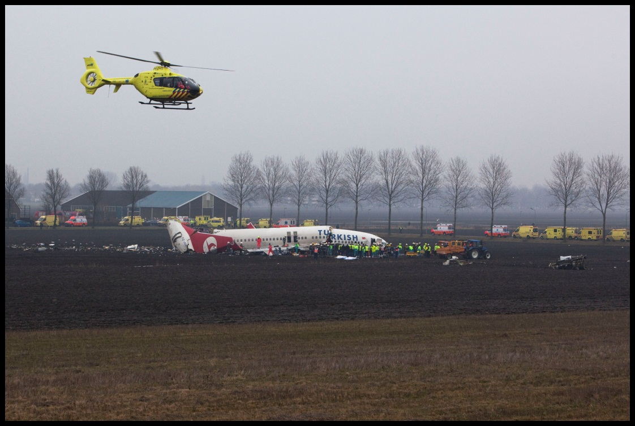
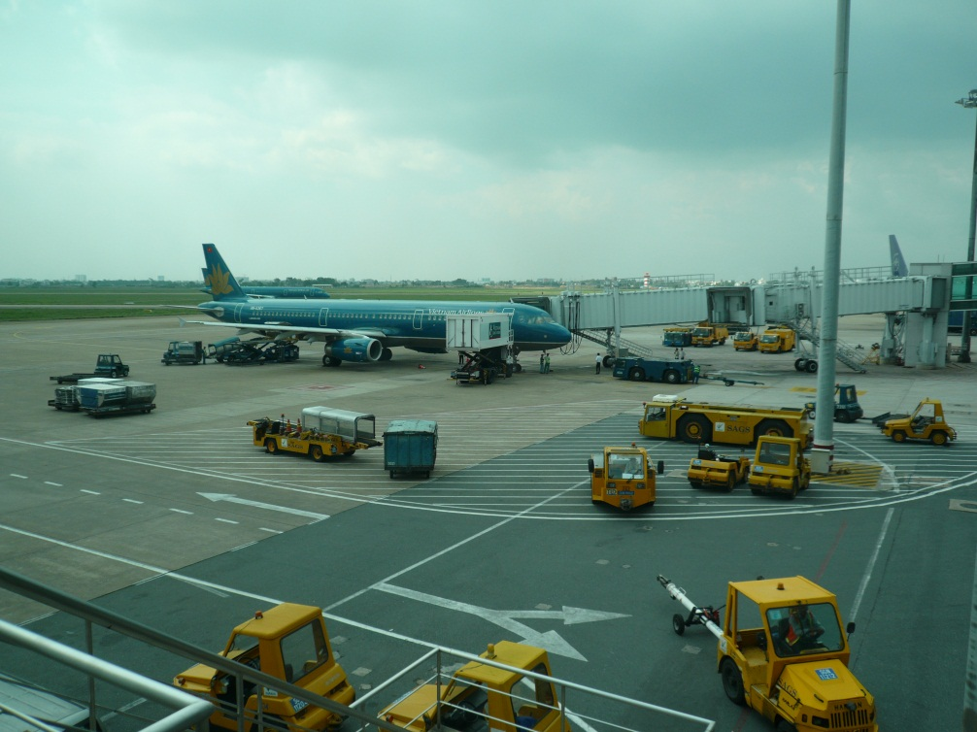
Why, what, how RRM?
The effective use of all available resources – people, equipment and information – to optimise personal and flight safety, and the efficiency of the aircraft turnaround.
Team Resource Management (ATC)
Maintenance Resource Management

Slide 3
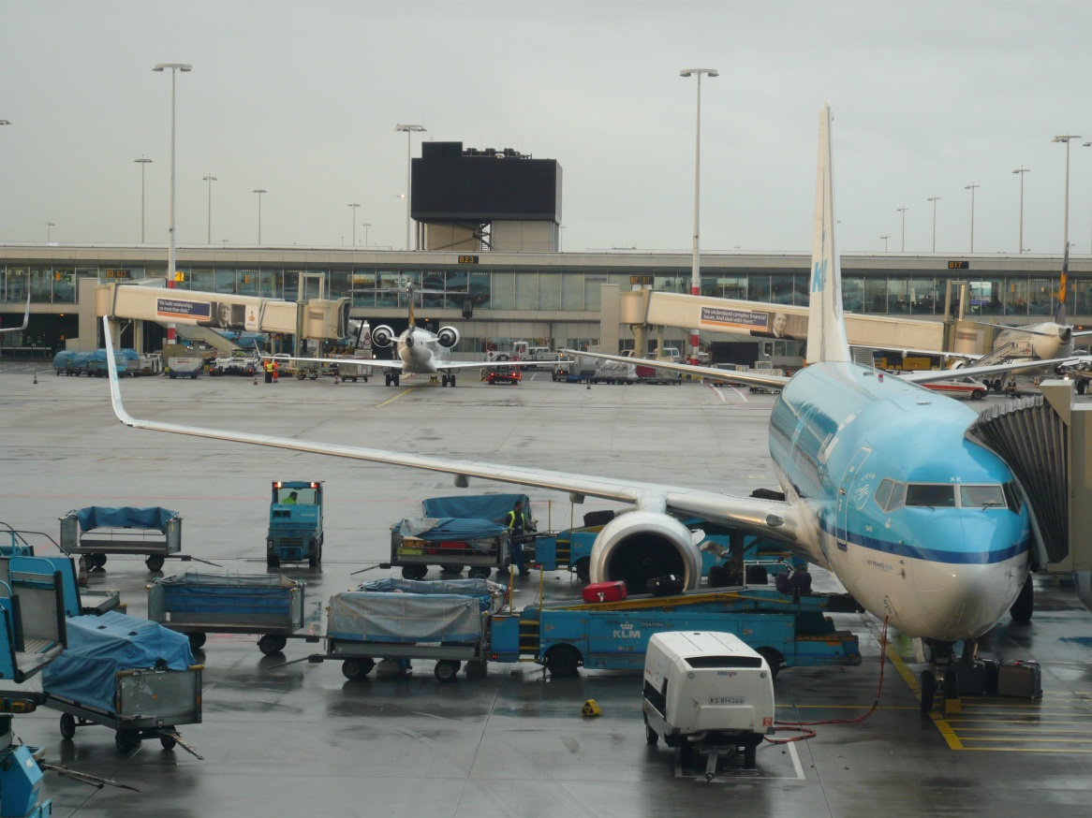
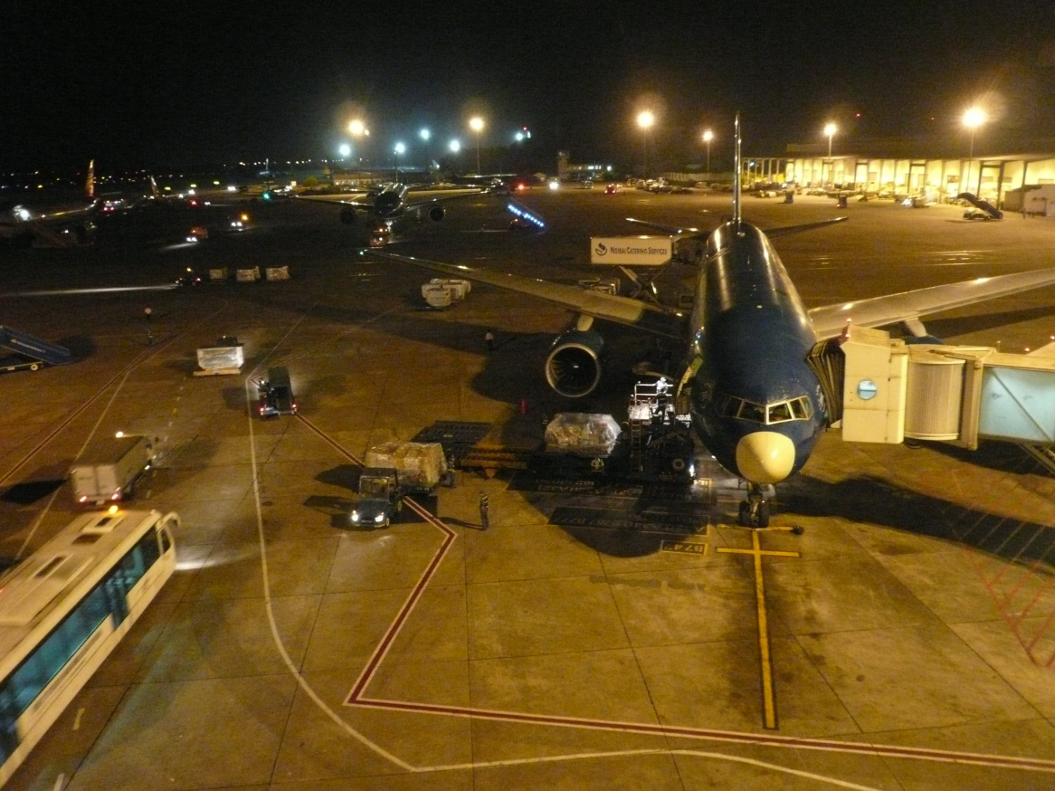
THE TURNAROUND PROCESS
http://www.youtube.com/watch?v=dktWiz7EL-8
Notes:
Show video
Ask how many different parties are involved
How many different people
Identify two or three tasks/point in the process where you have seen things go wrong

Slide 4
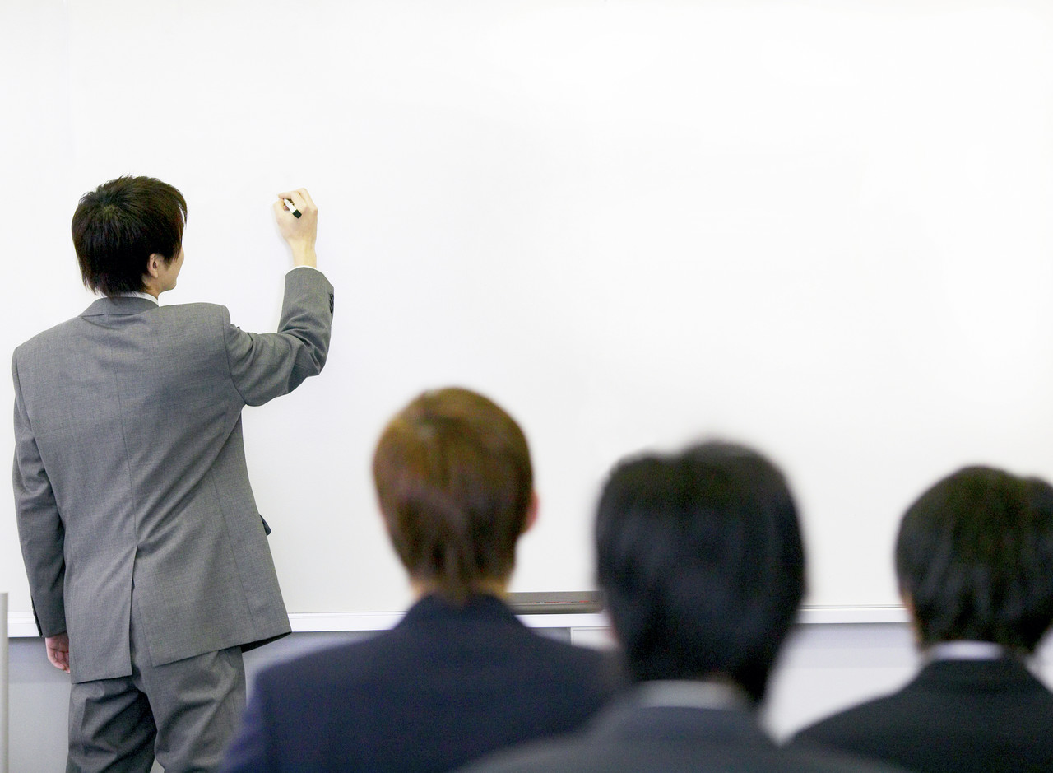
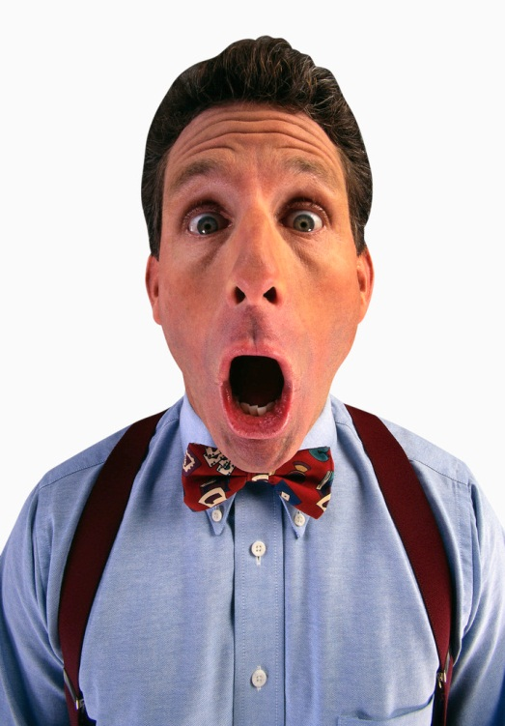
And this is what the process looks like on paper
Notes:
Emphasize the complexity and the interdependence the difference parties involved in the ramp activities
Dependencies
Time
Place
Information
Let everybody introduce him/herself and emphasize how many different people with different roles that are sitting in the classroom
Ask what influences there are on their work and the potential safety issues related to this (write on flip-over)
Disturbances
Weather
Resources (time, space, equipment, manpower)
Additional tekst
According to the Flight Safety Foundation, the ramp area is not a safe place to work in. Based on IATA data the FSF estimates that 27.000 ramp accidents and incidents occur worldwide each year. This corresponds with one incident or accident per 1.000 departures. For large airport with 500 aircraft turnarounds a day, this implies one incident or accident each two days. About 243.000 people are injured each year in ramp incidents and accidents, which equals 9 per 1.000 departures. In terms of costs, ramp accidents cost major airlines worldwide at least US$10 billion each year. These accidents affect airport operations, result in personnel injuries or damage the aircraft, facilities or GSE.
With regard to aircraft damage, this may go unnoticed until a catastrophic failure occurs. It is therefore of utmost importance to report any unusual contact with the aircraft by vehicles, equipment or tools.

Slide 5
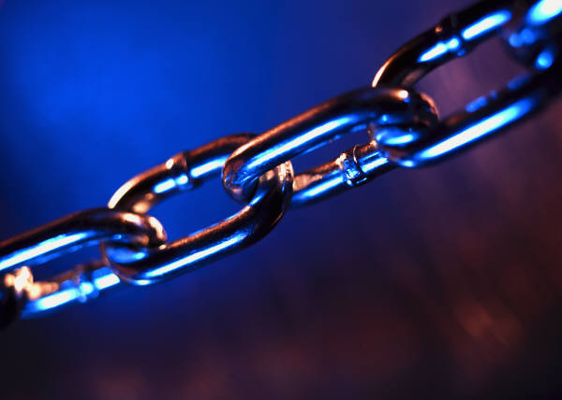
A CHAIN IS ONLY AS STRONG AS ITS WEAKEST LINK
Notes:
Emphasize that a chain is as strong as its weakest link and that the objective of this training is to support good practices and make effective use of all available resources:- people, equipment and information- to optimize the safety and efficiency of the aircraft turnaround.

Slide 6
Topics
Safety regulations
Teamwork
Team dynamics
Leadership
Communication
Team situational awareness
Cultural, ethnic and educational differences
Threat and error management
Human performance
Stress
Fatigue
Alcohol, medicines and drugs

