Slide 1
EASA eRules
Easy Access Rules in machine-readable format (XML)
16 March 2023
Second webinar

Slide 2
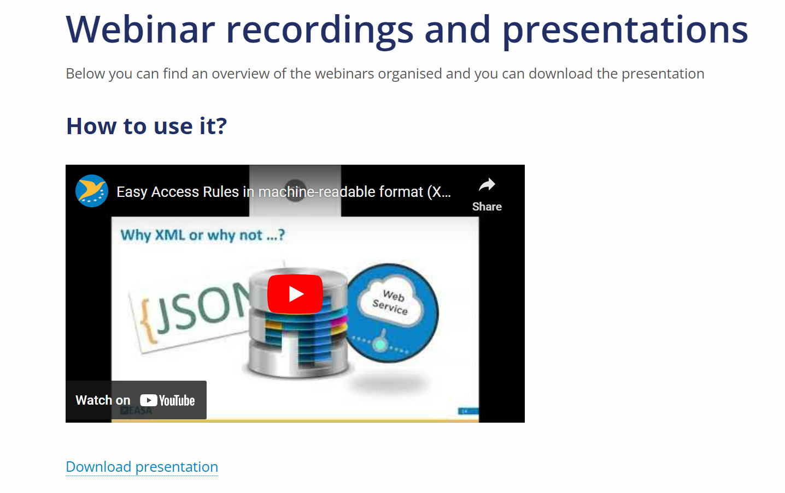
Steps taken after the first webinar
1. Presentation and video recording uploaded on the XML page
Easy Access Rules XML export - Powered by eRules | EASA (europa.eu)
2. FAQs were updated
Easy Access Rules XML | EASA (europa.eu)
Notes:
@Anna

Slide 3
Agenda
TIME | Subject
10:00 H – 10:05 H | Introduction and the agenda presentation (Anna Ngu)
10:05 H – 11:30 H | Working with an EASA Easy Access Rules XML file (Steffen Frederiksen) ------------------------------------------------------------------------------------------------ 1. Opening in MS Word Get an overview of the content Edit Save to other formats (e.g. HTML – with separate picture files, plain text, etc.) ------------------------------------------------------------------------------------------------ 2. Opening in an XML editor Show the package architecture Use simple “Find” to locate the er:document element Use an XPath expression to find the er:document element Use an XPath expression to locate a topic content, using the sdt-id attribute Identify the most relevant packages ------------------------------------------------------------------------------------------------ 3. Using a simple XSLT program to remove unwanted packages and elements and keep the text Walk through the XSLT example Show result ------------------------------------------------------------------------------------------------ 4. Using an XSLT program to extract the topics in separate XML files, using the values of ERulesId as file names Walk through the XSLT example Show result ------------------------------------------------------------------------------------------------ 5. Using an XSLT program to transform from XML to JSON Walk through the XSLT example Show result
11:30 H – 12:00 H | Questions and answers (All)
Notes:
@Anna

Slide 4
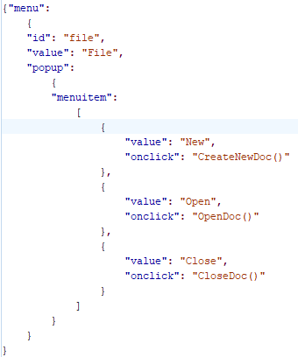
JavaScript Object Notation (JSON)
JSON, or JavaScript Object Notation, is a format used to represent data. It was introduced in the early 2000s as part of JavaScript

Slide 5

Questions?
Notes:
@Anna

Slide 6
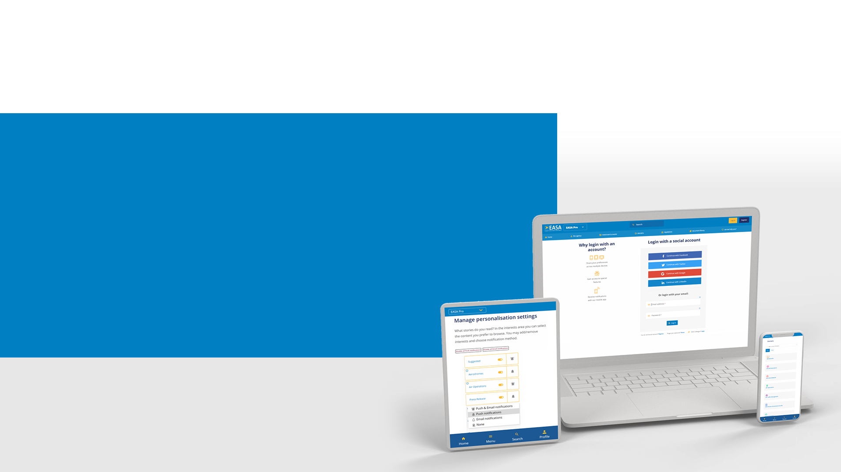

Stay informed - EASA Website
Interested in a specific Event?
1. Create an account on the EASA website
2. Go to the Event page of your interest
& Go to Get notified section, click Follow this item .
3. Decide how to stay informed
Your stream on the EASA Homepage
Email
Push notification
Go to the event
https://www.easa.europa.eu/en/newsroom-and-events/events/easy-access-rules-machine-readable-format-xml-how-use-it

