Slide 1
Ramp Resource Management Training
Version 1.0
Threat and Error Management

Slide 2
Topics
Safety regulations
Teamwork
Team dynamics
Leadership
Communication
Team situational awareness
Cultural, ethnic and educational differences
Threat and error management
Human performance
Stress
Fatigue
Alcohol, medicines and drugs

Slide 3
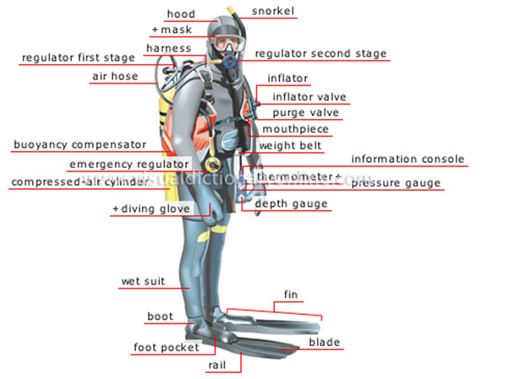
Threat and error management
How many errors do you make each shift?
How many errors are made during a shift?
How many accidents occur each shift?

Slide 4
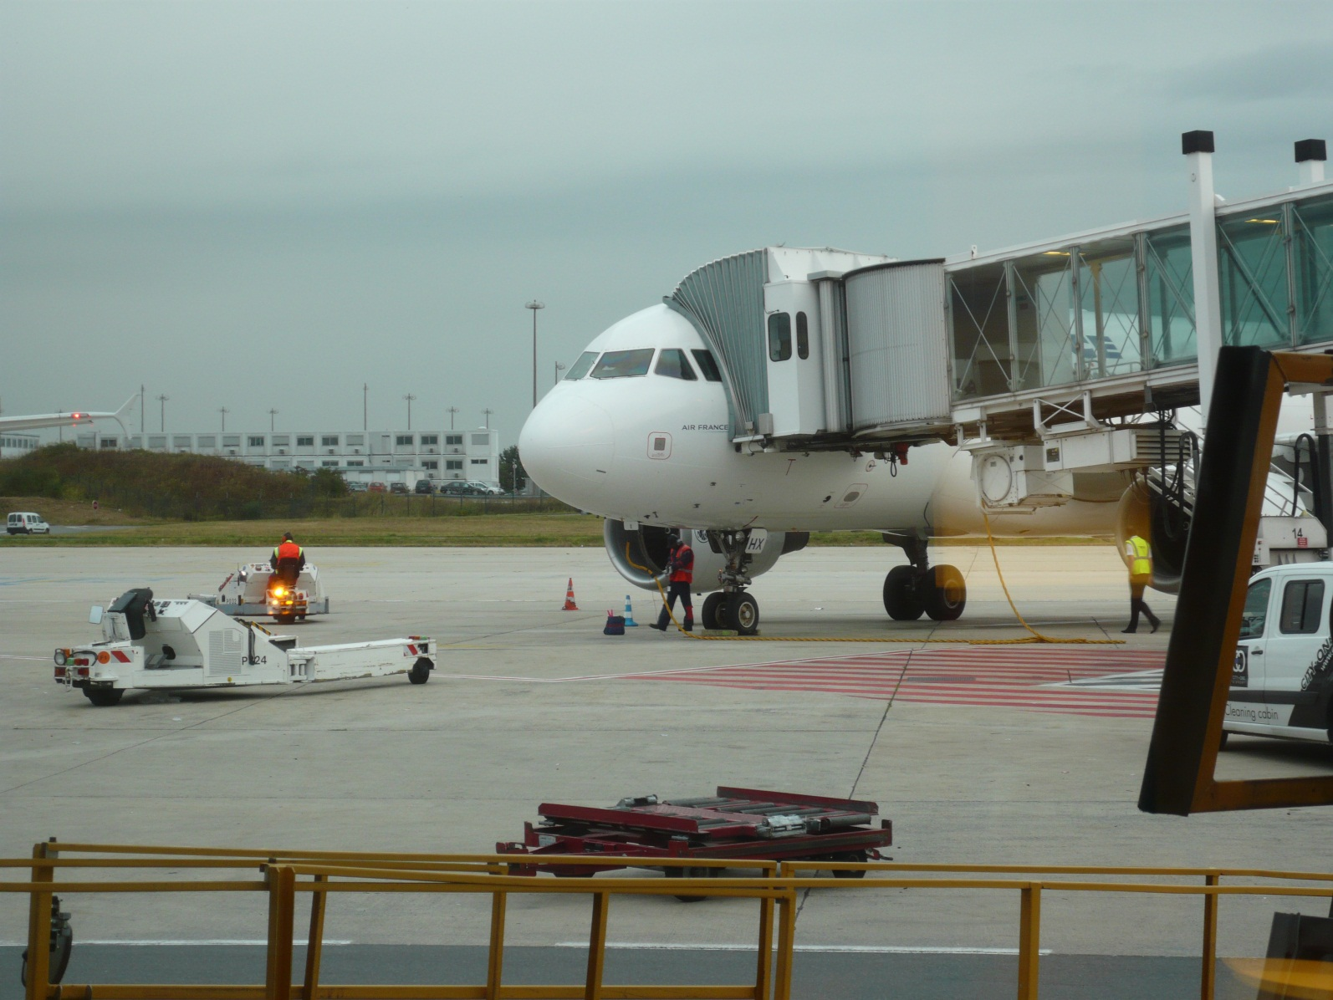
CASE: Towing
This incident is a fictitious mock-up using de-identified material. Names, dates, and conditions have been altered in order to stimulate thinking in a training environment. No connection to an actual incident should be inferred.
Notes:
Introduction of the topic: threat and error management.

Slide 5
Towing
Setting the scene:
XYZ Airline operates from Terminal at Any Airport
Crew consists of two ground support agents from a service provider
Crew is towing a fuelled B737-900 from remote parking to gate 71
Weather is clear, sunny, temperature 1 °C, wind is westerly at 29 km/h with gusts to 45 km/h
There are several icy patches on the ramp where aircraft have previously been di-iced with water/glycol
This incident is a fictitious mock-up using de-identified material. Names, dates, and conditions have been altered in order to stimulate thinking in a training environment. No connection to an actual incident should be inferred.

Slide 6
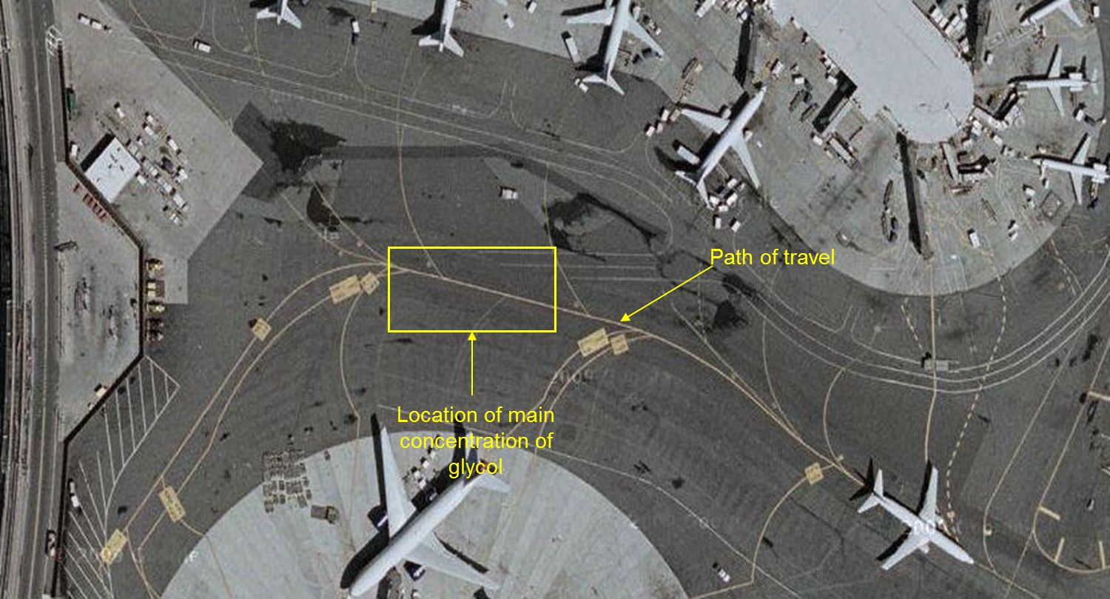
Towing
This incident is a fictitious mock-up using de-identified material. Names, dates, and conditions have been altered in order to stimulate thinking in a training environment. No connection to an actual incident should be inferred.

Slide 7
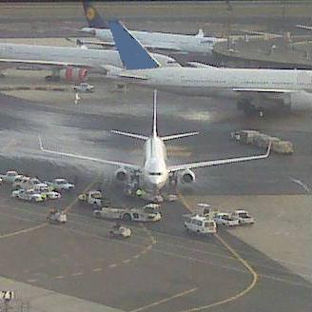
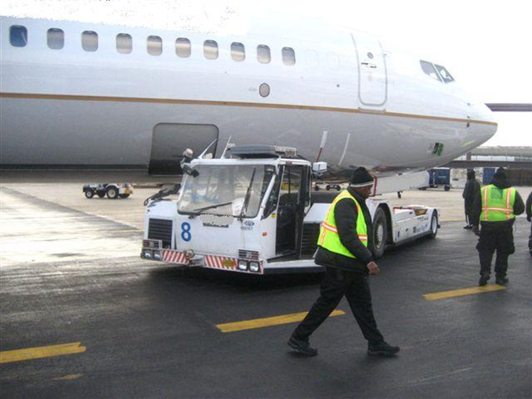
Towing
Suddenly, without warning, the tractor jackknifes under the aircraft nose, turning approximately 135 degrees
This incident is a fictitious mock-up using de-identified material. Names, dates, and conditions have been altered in order to stimulate thinking in a training environment. No connection to an actual incident should be inferred.

Slide 8
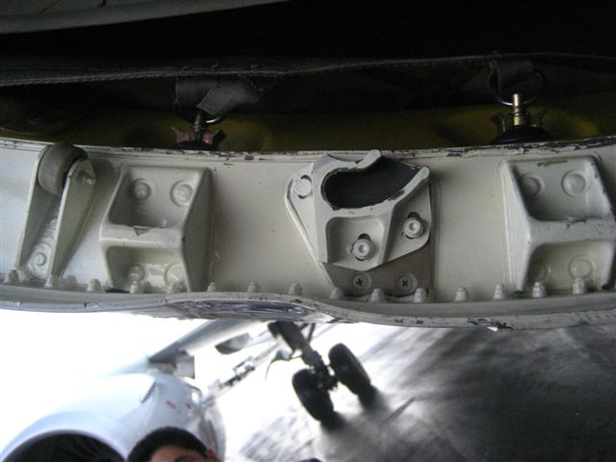
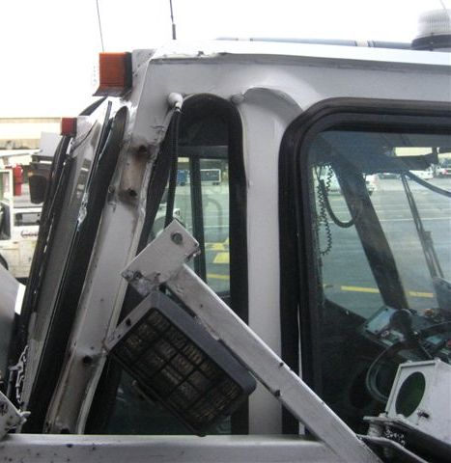
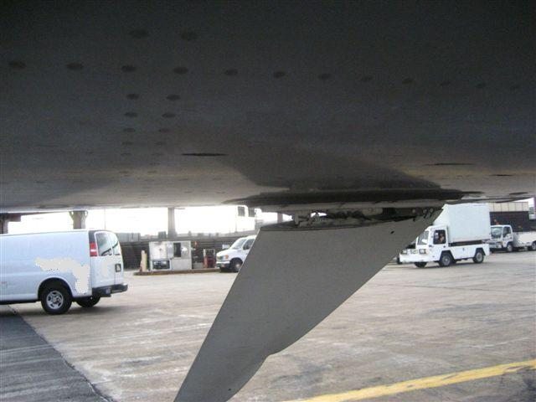
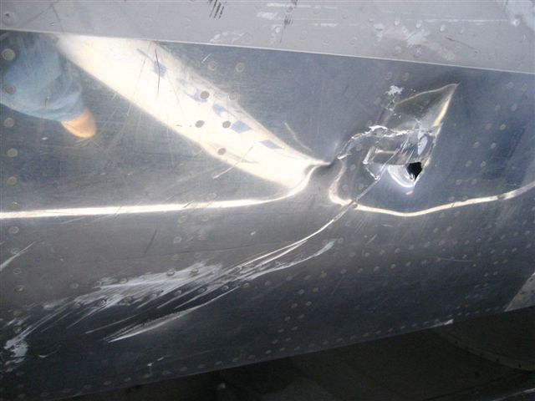
Towing
Light Bracket Sheared off
Buckled frame
Antenna Struck and Torn from Mount
Witness marks
This incident is a fictitious mock-up using de-identified material. Names, dates, and conditions have been altered in order to stimulate thinking in a training environment. No connection to an actual incident should be inferred.

Slide 9
Towing
Driver:
More than 7 years experience
Trained on the equipment approximately 6 months before
Worked 1 hour before the accident
Agent 2:
1 to 2 years experience
Trained on the equipment approximately 6 months before
Worked 1 hour before the accident
This incident is a fictitious mock-up using de-identified material. Names, dates, and conditions have been altered in order to stimulate thinking in a training environment. No connection to an actual incident should be inferred.

Slide 10
Towing
What are your thoughts on this?
Errors?
Equipment failure?
Airport layout?
Why do you think so?
This incident is a fictitious mock-up using de-identified material. Names, dates, and conditions have been altered in order to stimulate thinking in a training environment. No connection to an actual incident should be inferred.

Slide 11
Threat and Error management
Notes:
The Threat and Error Management (TEM) framework provides a practical way to describe all factors that may degrade safety and how they can be managed.
Threats are defined as events or errors that occur beyond the influence of ramp personnel, increase operational complexity, and which must be managed to maintain the margins of safety. It is assumed that threats cannot directly be controlled by ramp personnel, like adverse weather conditions, so the focus is not on avoiding threats, but on managing them.
Threats during the aircraft turnaround may be divided into:
Expected threats (e.g. time pressure, adverse weather conditions, staff/equipment shortage, aircraft handling at adjacent stand, etc.), and
Unexpected threats (e.g. equipment failure, fuel/dangerous goods spill, emergencies, etc.)
Threats may also be divided into:
Internal threats (e.g. equipment, procedures, fellow workers, etc.);
External threats (e.g. handling area layout, airport layout/equipment, adjacent handling areas, etc.);
Environmental threats (e.g. weather conditions, fumes, etc.).

Slide 12
Threat and error management
What are expected and unexpected threats?
What are internal, external and environmental threats?
Did you ever experience threats and how did you deal with those threats?

Slide 13
Threat and Error management
Identify the threat: weather forecast, planning, equipment status
Assess the risk: severity, probability and exposure
Prepare: notify team members, request wing walkers, lock loose equipment
Monitor the threat: recognize distractions, interruptions and preoccupation
Notes:
Whether overt or latent, expected or unexpected, threats may be managed in four basic steps:
Identify the threat (e.g. weather forecast, planning, equipment status);
Assess the risk (severity, probability and exposure);
Prepare (e.g. notify team members, request wing walkers, lock loose equipment);
Monitor the threat (recognize distractions, interruptions and preoccupation).
The first responsibility in threat management rests with flight dispatch and supervisors. By means of planning, briefings and preparations they are able to manage anticipated and unexpected threats and employ the necessary resources (planning countermeasures). Supervisors have to show good leadership and establish adequate communication to best prepare their teams (team countermeasures) to manage known threats. In a good team safety culture, all team members take responsibility to perform the countermeasures individually. Therefore, team member participation is essential in adequate threat management.
During the actual aircraft turnaround, existing threats have to be monitored for possible deterioration, and vigilance has to be kept to identify new threats. For example, flight dispatch may relay real-time information to supervisors concerning weather developments or disturbances in flight/turnaround schedules.
Countermeasures to employ during the turnaround are e.g.: scanning what is going on around you and cross-checking other ramp workers (execution countermeasures).
When conditions or threats change during the turnaround, countermeasures have to be reviewed or modified to manage the existing or new threats adequately. When more threats are detected or the risk of existing threats becomes more severe, the more reason there is to adapt the operation. Timely recognition of threats and adequate threat monitoring also enables flight dispatch and supervisors to manage the workload and resources adequately.

Slide 14
Situational awareness
Look around before you start shit

Slide 15
Threat and error management
Stupid! vs Consequences of
normal human activity

Slide 16
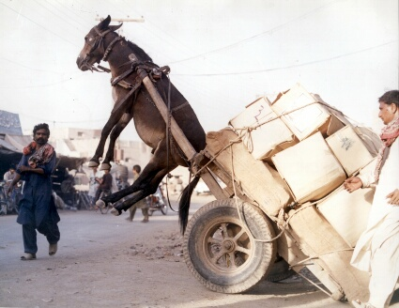
Threat and error management
Human Error Low Tech
16

Slide 17
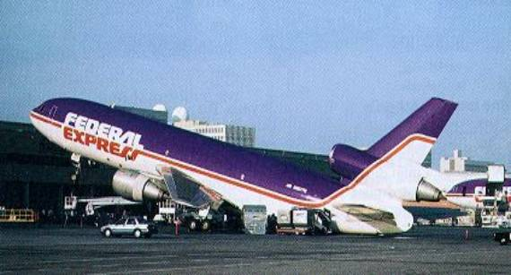
Threat and error management
Human Error High Tech
17

Slide 18
Threat and error management
Different reactions to errors:
Ignored : forgetting to place cones or parking of Ground Service Equipment within the aircraft movement zone
Exacerbated: the combination of a not fully opened cargo door and an inattentive high loader operator increases the risk of aircraft and equipment damage
Trapped: this requires team situation awareness and an active attitude from team members to trap and correct errors – not only their own, but also errors made by fellow workers
Report errors to learn and prevent!!!
Notes:
Errors can either be:
Ignored;
Exacerbated; or
Trapped.
In the course of the activities during the aircraft turnaround, errors may be easily ignored due to the pressure to meet the scheduled turnaround time. Examples may be: forgetting to place cones or parking of Ground Service Equipment (GSE) within the aircraft movement zone.
However, errors may also be exacerbated, for example: the combination of a not fully opened cargo door and an inattentive highloader operator increases the risk of aircraft and equipment damage. The same applies when an aircraft is incorrectly (aft) loaded and boarding is started in the aft section of the cabin. Both examples describe chains of errors, creating an undesired state that could easily lead to an incident or accident when no emergency action is taken.
Therefore, to prevent incidents and accidents it is of vital importance to trap errors made during the aircraft turnaround. This requires team situation awareness and an active attitude from team members to trap and correct errors – not only their own, but also errors made by fellow workers.
Errors may have graver consequences when certain threats are present. The risk created by forgetting to place cones underneath the wingtips or parking GSE within the aircraft movement zone is increased during low visibility conditions or a very congested ramp. Likewise, the risks of incorrect loading and an early boarding is increased when the turnaround process is delayed for whatever reason.

Slide 19
I could have saved a life that day
I could have saved a life that day, but I chose to look the other way. It wasn’t that I didn’t care, I had the time, and I was there. But I didn’t want to seem a fool, or argue over a safety rule. I knew he’d done the job before, if I pulled him up, he might get sore. The chances didn’t seem that bad, I’ve done the same, he knew I had. So I shook my head and walked on by, he knew the risks as well as I. He took the chance, I closed an eye, and with that act, I let him die. I could have saved a life that day, but I chose to look the other way. Now every time I see his wife, I’ll know I should have saved his life. That guilt is something I must bear, but it isn’t something you need to share. If you see a risk that others take, that puts their health or life at stake. The question asked, or thing you say, could help them live another day. If you see a risk and walk away, then hope you never have to say, I could have saved a life that day, but I chose to look the other way.
Written by Brian McMillan

Slide 20
Threat and Error management
Threats
Identify, assess, prepare & monitor
Errors
Trap & correct
Undesired
state
Emergency action
Consequences
Notes:
Emergency action
When a combination of miss/unmanaged threats and errors lead to an undesired state, emergency action have to be taken to avoid an incident or accident.
To recognise an undesired state, ramp personnel have to be aware of irregularities or anything that is unusual. For example, a fully extended nose strut may indicate that a tail tip is imminent due to, for example incorrect loading, incorrect boarding or a combination thereof. To avoid the tail tip (manage the undesired state) boarding has to be stopped immediately. Again, team situational awareness is of vital importance to detect an undesired state and take appropriate emergency action.

