Slide 1
Ramp Resource Management Training
Version 1.0
Human Performance & Limitations

Slide 2
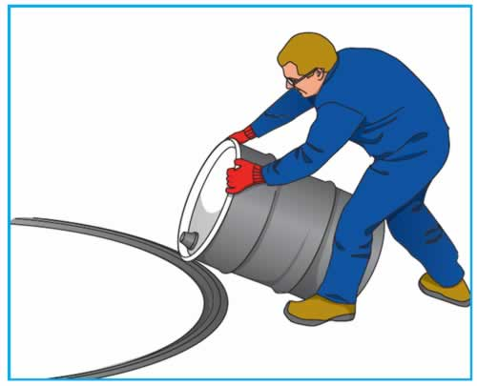
Human Performance & Limitations

Slide 3
Topics
Safety regulations
Teamwork
  Team dynamics
  Leadership
  Communication
  Team situational awareness
  Cultural, ethnic and educational differences
Threat and error management
Human performance
  Stress
  Fatigue
  Alcohol, medicines and drugs

Slide 4
Stress
“The total absence of stress is death”
  Dr. Selye; pioneer in human stress research

Slide 5
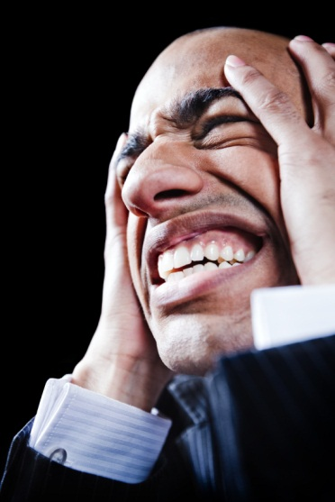
Stress: 4 categories
physical stressors
  noise, temperature............
physiological stressors
  sick, lack of sleep............
psychological stressors
  time pressure, work pressure, emotional factors.........
psycho-social stressors
  personal relationship problems.........
Cumulative!
5
Notes:
See table in rmm syllabus

Slide 6

Stress Reactions
Physical
  Increased heart rate
  Tremors
  Feeling hot
Emotional /Behaviour
  Anger
  Quiet
  Nervous behaviour (tapping)
Cognitive (Thinking)
  Less capacity
  Slower thinking process
  Forgetting
6
Notes:
Refresher CRMKLu
6
See RMM table 4 for stress symptoms
All stress factors have in common that they represent some kind of change on which an individual has to react. Whether stress factors cause a negative effect depends on the response, and the response is determined by an individual’s perception of the stress factor. The way stress factors are perceived depends on:
How a person feels;
The stress factor itself;
The evaluation of the stress factor;
Personality;
The ability and willingness of others to provide support.

Slide 7
Stress and performance
P
Stress
7

Slide 8
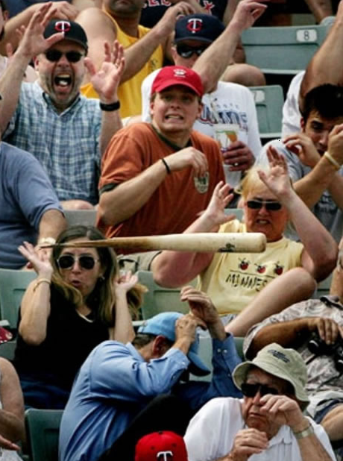
Personal examples of stressors
8

Slide 9
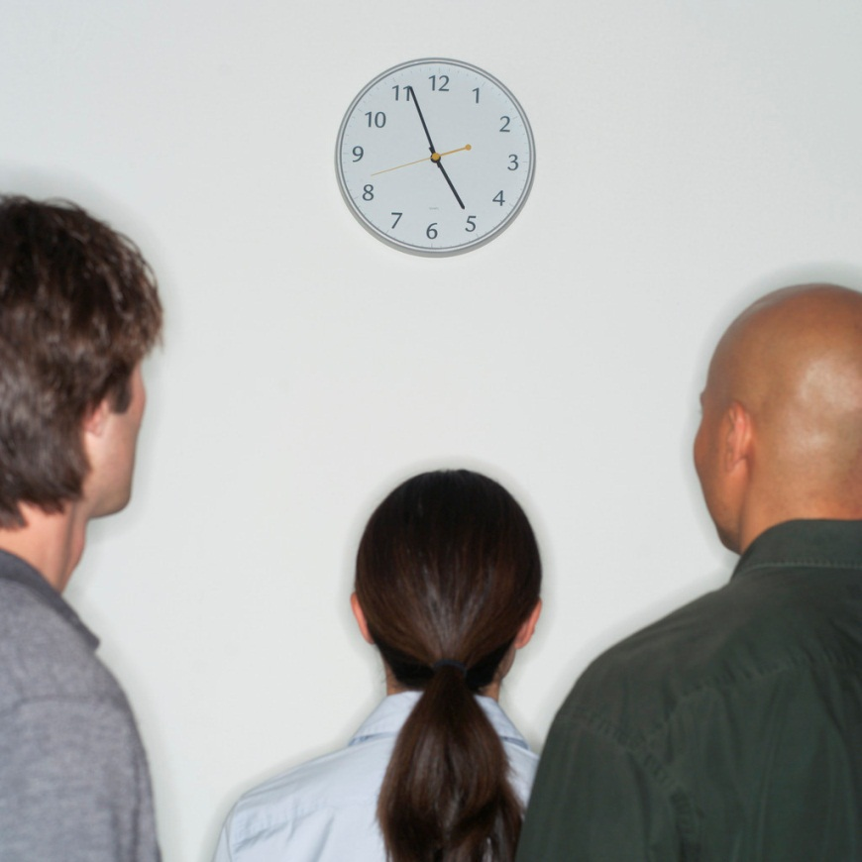
Stress through time Pressure
What is the influence of time pressure on job performance?
What are possible causes of time pressure?
Notes:
Time pressure is one of the causes that leads to stress and stress has a negative influence on safety:
Lack of concentration;
Inadequate decisions;
Inadequate communication;
Taking shortcuts;
Incomplete tasks;
Omissions;
Errors;
Violations;
Taking over/completing other’s job;
Possible causes of time pressure are:
ou have too much work,
You are demaning too much of yourself,
You are not assertive enough,
You don’t have enough training or experience,
Your department is undermanned,
You are paying too much attention to side issues,
You have too much ad-had activities,
Your work environment is too turbulent,
You are working under your level or have too little work,
You don’t take brakes.

Slide 10
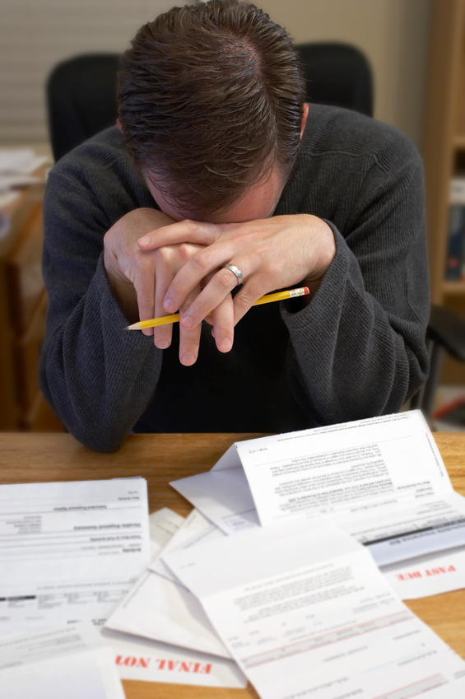
Stress reactions: coping
Active
Palliative reaction: smoking, relaxing... (Vodka!)
Avoidance (humour)
Emotional expression: anger....
Social support
Passive: depression
Comforting thoughts
10
Notes:
Coping is the the manner in which a person deals with the environment requirements of that moment with regard to behavior, cognition and emotions.
It is a process that excists out of a lot of different component, constantly depending on new situations and experiences.
Coping as problem solving behavior has a certain effect. The result can be effective or not effective.
1. Active: Calmly look at the situation from different angels, put things in a right order and start working to solve the problem goal oriented and with self-confidence.
2. Palliative reaction: seek for distraction, keep yourself occupied with other things to not think about the problem, try to feel more comfortable by smoking, drinking, relaxing.
3. avoiding: waiting: see what will happen, leave things as they are.
4. Seek for social support: seek for understanding or comfort with others, discuss your sorrows with somebody or get help.
5. Passive reaction pattern: being completely occupied by the problems and the situation, see the dark site of the matter, withdraw from social activities, not being able to do something about the situation, worrying about the past.
6. Expression of emotions: showing anger, irritation, tensions, venting displeasure on somebody else.
7. Apply comforting and reassuring thoughts : re-comfort yourself with thoughts like: after rain comes sunshine, others have also difficulties, there are worse things than this, it could be worse.

Slide 11
Active stress management
11
Being aware of negative effects of time pressure
Sufficient resources
Planning & preparation
Setting boundaries
Solve personal problems (!)
Recognise and reduce self-induced stress
Use colleagues spare capacity
Notes:
Time pressure is best prevented by doing as much as possible in advance and being prepared for the time pressure. This can be done by:
Being aware of the negative effects of time pressure on performance:
Providing for sufficient resources (manpower, serviceable equipment);
Positioning and checking equipment prior to aircraft arrival;
Briefing ramp personnel about the work to expect;
Planning to share the workload;
Regular communication with supervisors or turnaround coordinators about progress and schedule updates.
In case of actual time pressure, it is important to:
Prioritise tasks;
Deal with one task at a time;
Finish the task;
Ask assistance when available.

Slide 12
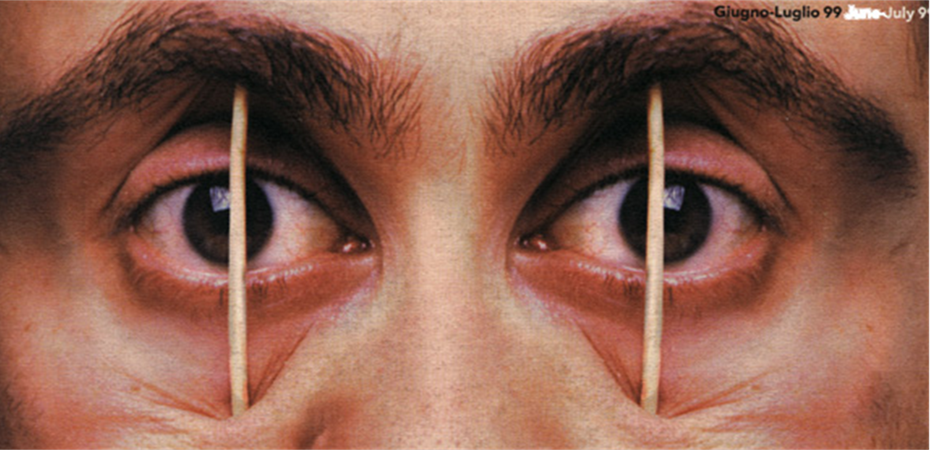
Fatigue

Slide 13
Driving ...................and just a bit of sleeping
http://www.youtube.com/watch?v=mIcG2lnDmqk

Slide 14
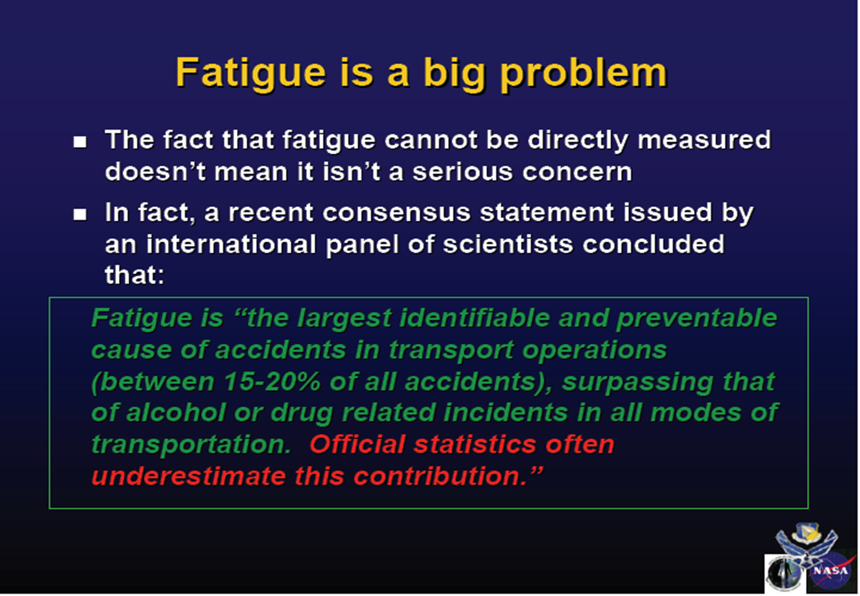

Slide 15
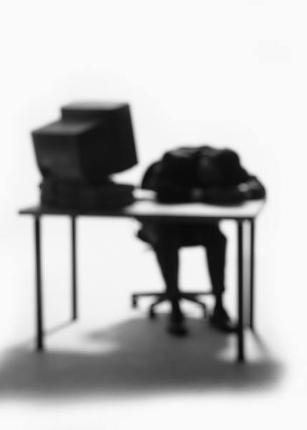
Fatigue
How do you recognise signs of fatigue?
Yourself
Others

Slide 16
Fatigue management
EMPLOYER RESPONSIBILITIES
Ensuring safe work practices (e.g. Sensible overtime procedures).
Ensuring good work systems (e.g. scheduling work at appropriate times of the day).
Appropriate and safe roster design to allow for adequate recuperation.
Appropriate and safe shift length.
EMPLOYEE RESPONSIBILITIES
Fitness for work (e.g. adequate rest and recuperation).
Lifestyle management (including the use of drugs and alcohol).
Incidence reporting (of fatigue-related incidents).
Sleep well
SHARED RESPONSIBILITY!
http://www.mirsa.com.au/docs/Fatigue_Management.pdf

Slide 17
Fatigue management
DO
Eat your main meal at midday or early evening.
Eat light meals at night.
Allow at least three hours to digest food before sleep.
Eat pasta, grains, sandwiches, salads etc. at night as they are easily digested.
Drink reasonable amounts of liquid.
Don’t
Eat large meals in the middle of the night.
Eat food high in sugar and fat, especially ‘fast food’.
Eat lots of protein at night, such as red meat, as it is difficult to digest.
http://www.mirsa.com.au/docs/Fatigue_Management.pdf

Slide 18

Alcohol, Medicines and drugs
Notes:
As stated before, consumption of alcohol has a negative effect on the quality of sleep and should therefore not be used when an adequate rest period has to be taken prior to work or a shift pattern. Going to sleep after alcohol consumption may slow down the removal of alcohol from the blood since the metabolic system operates at a lower level. Alcohol remains in the blood for a considerable period of time, especially when the alcohol is taken in combination with food. Therefore, negative effects from alcohol may still be experienced about 8 hours after the last drink. Negative effects include dulled senses and increased mental and physical reaction times. These effects are worsened in combination with medicines or fatigue.
Medicines are used to treat the symptoms of some sort of illness. When medicines are used by ramp workers, they first have to ask themselves whether the reason for taking the medicines still renders them fit to perform their tasks safely. Working when being ill affects performance, may cause incidents or accidents, or fellow ramp workers may be infected, which has an increased impact on work schedules. When medicines are taken for the first time, a doctor has to be consulted about their potential negative effects on work performance. Moreover, care has to be taken when taking medicines for the first time, since unexpected reactions may be experienced. Potential effects of medicines may not be underestimated, since even medicines against colds or hay fever may cause drowsiness.
Drugs have a significant negative effect on performance and are not to be used in aviation. Even smoking cannabis impairs performance since it affects the ability to concentrate, retain information and make reasoned judgments.

