Slide 1
Ramp Resource Management Training
Version 1.0
Safety regulations

Slide 2
Topics
Safety regulations
Teamwork
  Team dynamics
  Leadership
  Communication
  Team situational awareness
  Cultural, ethnic and educational differences
Threat and error management
Human performance
  Stress
  Fatigue
  Alcohol, medicines and drugs

Slide 3
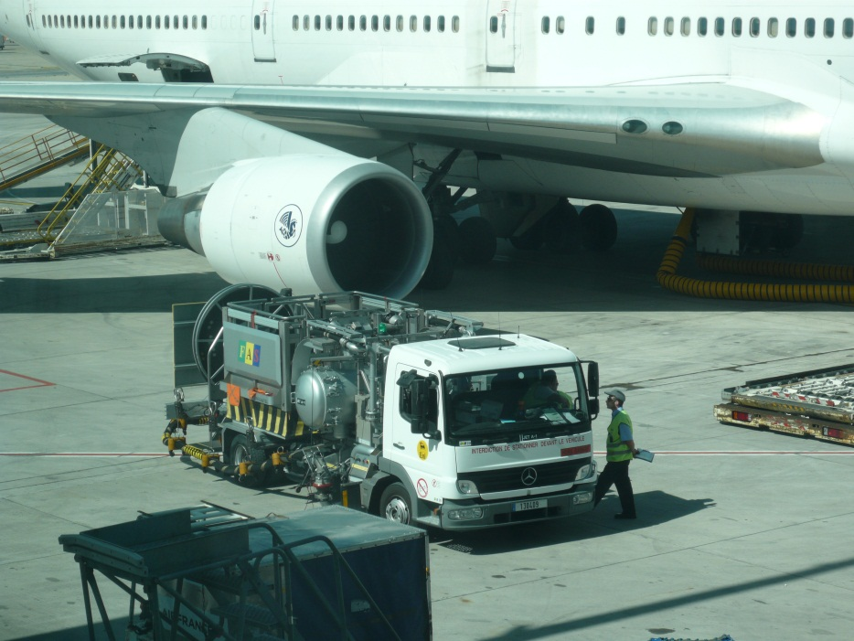
Safety regulations
What is safety?
How can you create safety?
Organisation or own responsibility?

Slide 4
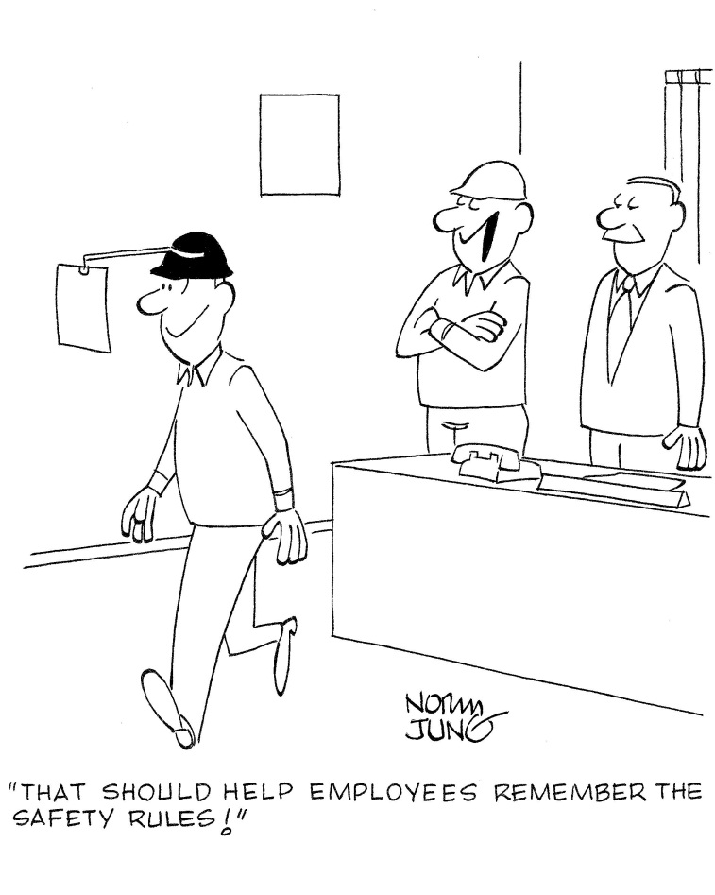
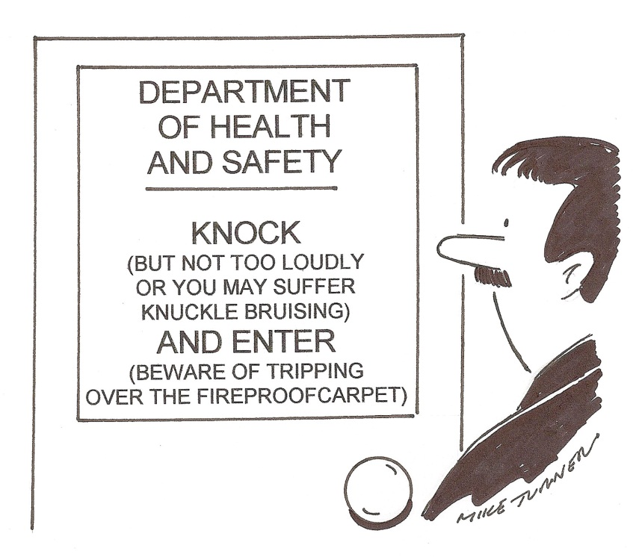
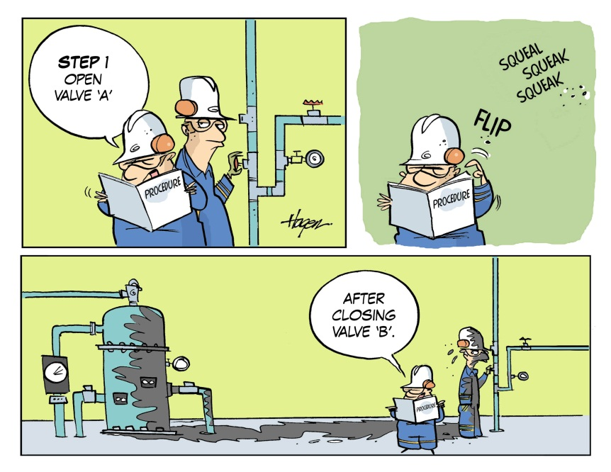
Safety regulations
Notes:
Emphasize that you still have to think while using procedures!

Slide 5
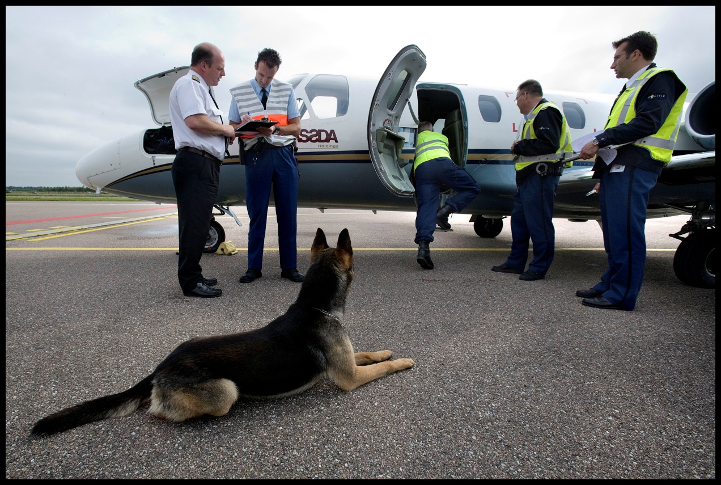
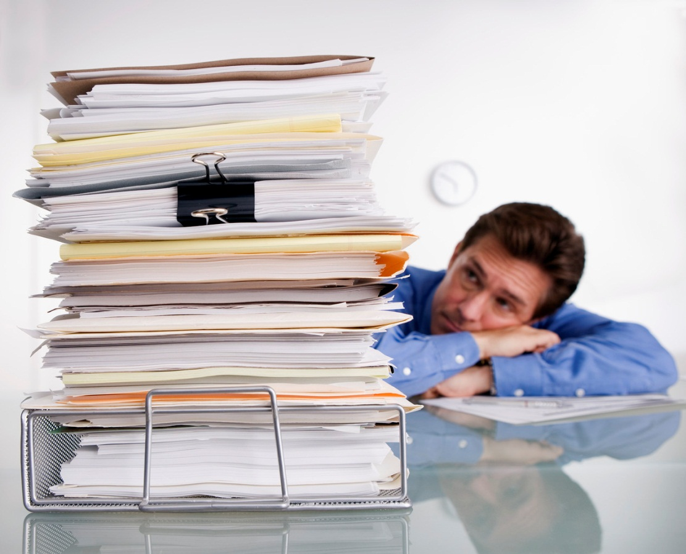
Safety regulations
Notes:
Explain that the European Union (EU)-OPS regulations specify minimum safety and related procedures with regard to the aircraft turnaround process:
Appropriate ground handling facilities to ensure the safe handling of its flights;
Ground facilities and services required for the planned flight are available and adequate;
The load is properly distributed and safety secured;
The mass of the aircraft, at the commencement of take-off roll, will be such that the flight can be conducted in compliance with the applicable regulations concerning aircraft performance.
Taxi-in, passenger (dis)embarkation, pre-flight check, receipt of Passenger Information List, receipt of fuel upload, receipt of NOTOC, loadsheet completion and pushback.
Emphasize that procedures help to operate with greater consistency, both in its internal and external workings. Next to the EU there are also internal company procedures.

Slide 6
Safety regulations
Why have Standard Operating Procedures
SOP’s identify specific actions
SOP’s explain when to take actions
SOP’s describe ALTERNATIVES
SOP’s show EMERGENCY procedures
SOP’s include WARNINGS & CAUTIONS
SOP’s improve COMMUNICATION
SOP’s support a better WORKLOAD MANAGEMENT
SOP’s specify PRIORITISATION of duties
SOP’s set LIMITS or acceptable tolerances
SOP’s allow an inter-changeable crew composition
Notes:
Make clear that next to the EU there are also internal company procedures, aks what procedures do (SOP’s) and show slide. Emphasize that procedures help to operate with greater consistency, both in its internal and external workings.

Slide 7

Why do people not follow SOP’s?
Intentional
  Criminal
  Lazy
  Anti-authority (I know better)
  Short cuts
  Impossible to do job AND follow SOP’s
  ..............
Unintentional
  Not aware of SOP’s
  Culture
  Fatigue
  Stress
  Human Error
  ..................
Notes:
Ask why people not follow SOPs and then show slide

