Slide 1


EASA Annual Safety Review 2023

Slide 2
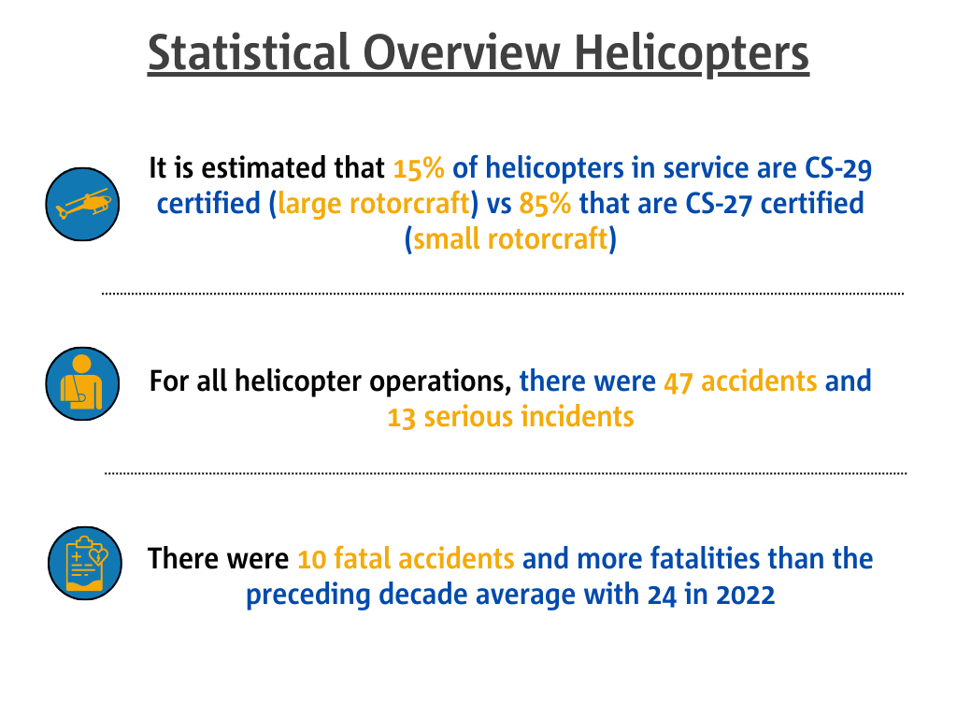

Slide 3
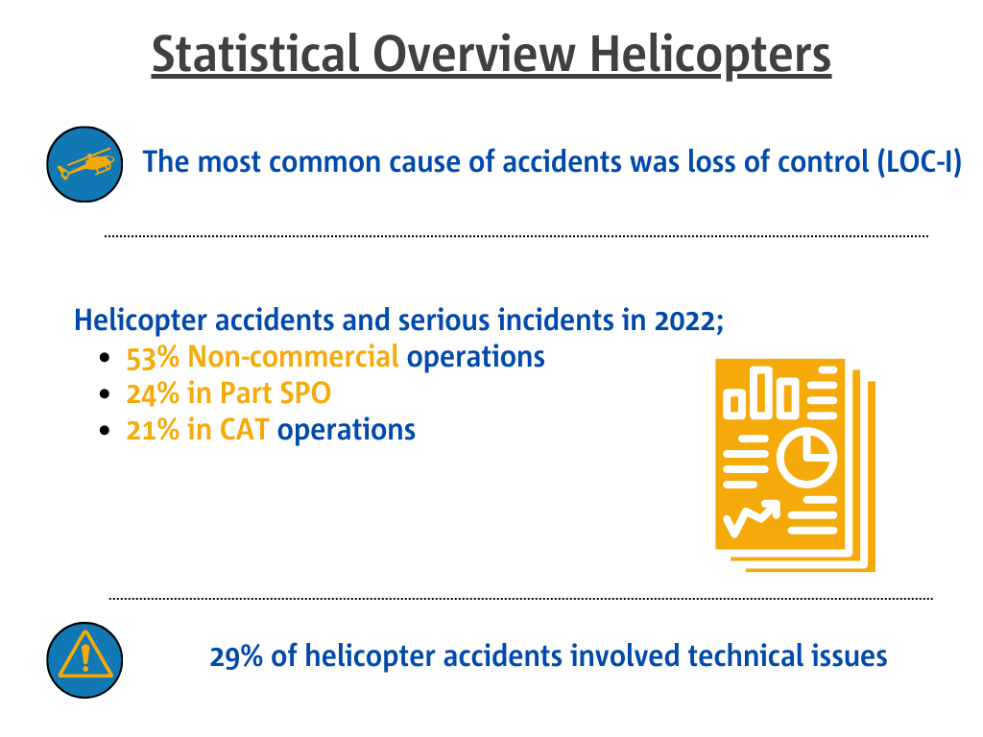

Slide 4
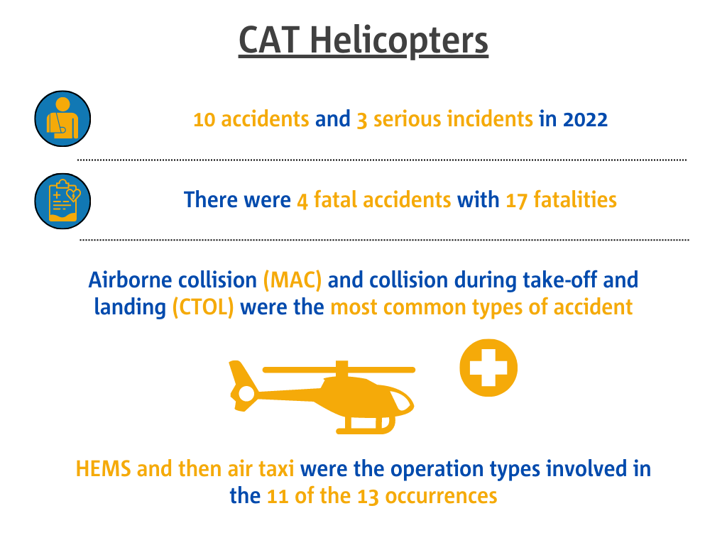

Slide 5
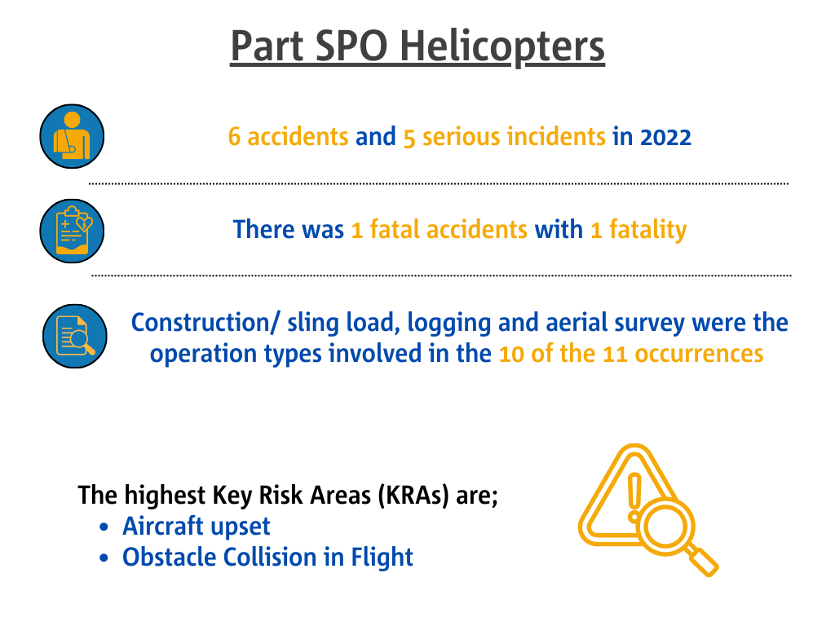

Slide 6
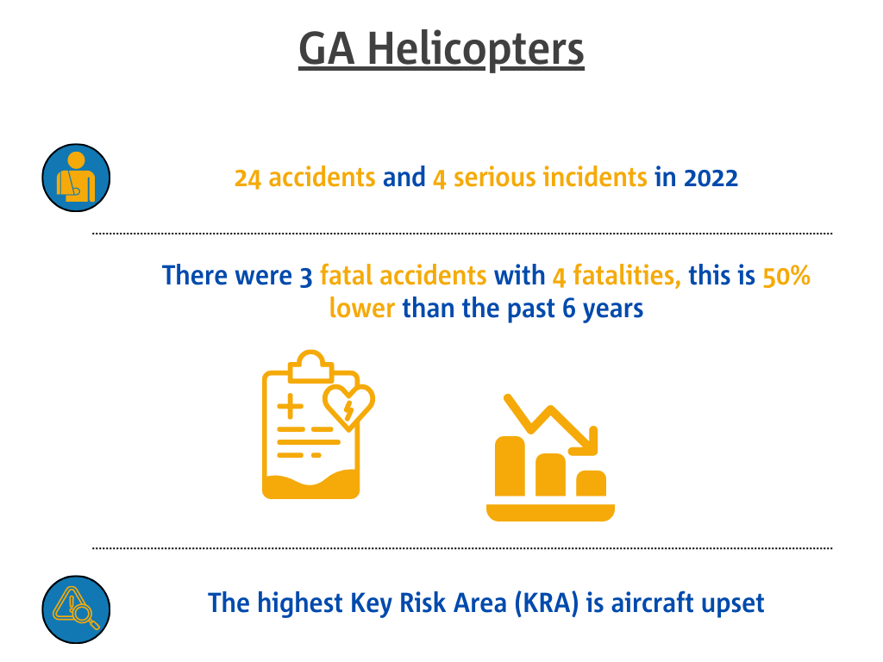

Slide 7
For more details check out the Annual Safety Review on the EASA Website and the Domain Specific material on the Community Sites

