Slide 1
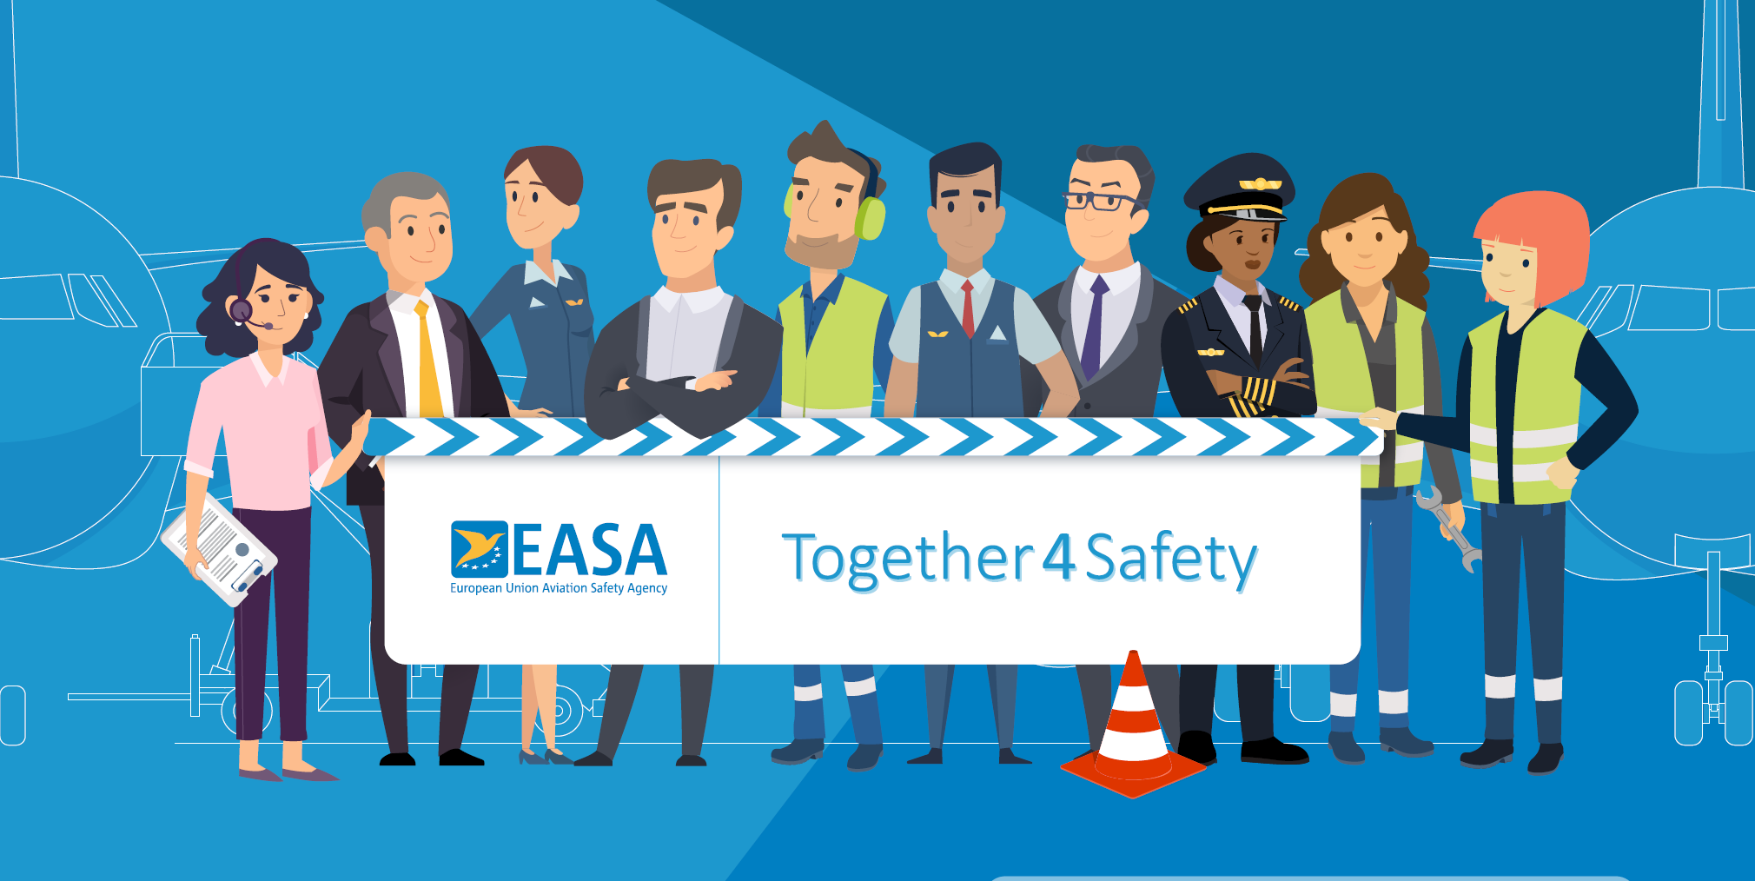
Stronger and Safer Together, Always

Slide 2
With Thanks to the Following Organisations Who Supported the Development of this Material
Human Factors Wellbeing Group

Slide 3
Campaign Supporters
Human Factors Wellbeing Group

Slide 4
Its purpose and what it stands for
""To provide useful information that engages people in positive conversations about safety so that the aviation community can deliver the safety capacity needed to ensure safe operations"
Collaborative
Useful and Supportive
We collaborate to understand the challenges industry are facing and work hard to help develop practical solutions.
We collaborate to understand the challenges industry are facing and work hard to help develop practical solutions.
Plain Speaking
Engaging
We use plain, simple language that seeks to provide the clarity people need to easily understand often complex information without talking down to them.
We start positive conversations about safety that gets people thinking and provide the tools and information industry needs.

Slide 5
The "Always" Campaign
Stronger, Safer, Together - Always
Safety is not a process or an outcome. It is the capacity of all stakeholders in the aviation system to collectively contribute to
safe and effective operations, every single day - always
The importance of a collaborative, industry-wide campaign
Aviation relies on all actors working in a coordinated and connected way.
We achieve more we align our core values and work together with common goals
We focus on key activities, actions and behaviours that are at the heart of safe operations

Slide 6
Be Ready, Stay Safe - Driving Safe Operations
Be Ready means
Stay Safe means
Having enough skilled, trained and qualified people who are operationally ready and fit for duty.
Ensuring that you have the right tools, equipment and infrastructure in place.
Defining and living by the values that creates the trust needed to support positive safety conversations.
Encouraging people to do things the right way by following the relevant processes, procedures and practices.
Knowing your risks and mitigating them effectively as part of a resilient management system.
Inspire your teams to talk about safety and then having a positive approach to learning and solving problems.

Slide 7
The Audience for the Campaign?
This package is for organisations and particularly for leaders and managers who are developing their own Ramp-up preparations.
Organisations should use this material to support a people-centred Ramp-up as it relates to their own operation (add your logo to the top right of the main powerpoint slides and go!)
It is designed to help staff representatives in supporting their organisations and colleagues during the Ramp-up.
This material is designed to align our ramp up approaches across the industry and to save you time when developing your own messages.

Slide 8
What is in the package?
Defining the campaign, its goals and values
What is "Be Ready" and "Stay Safe"
Examples of the key actions for each of the domain groups
Domain safety issues
Domain Ramp-up resources
Safety posters

Slide 9
What you can do with the material?
Go to the EASA Air Ops Community to get access to the Safety issues report and other Ramp-Up Resources.
Use the campaign material within your own organisations during the summer and beyond - the messages are for always.
Register for the domain discussions at the EASA Safety Week between 26-28 June (Register via the EASA Website)
Join the ongoing discussions with our Conversation Aviation webinars and on the LinkedIn Group.

Slide 10
Domain Based Actions and Behaviours
Flight Crew
Airport/ Ground Handling
ATM/ANS
Cabin Crew
Engineers

Slide 11
General Ramp-Up Resources
EASA - COVID-19 Resource Hub
IATA - COVID Resources
ACI - COVID Resources
CANSO - COVID-19 Restart and Recovery Guide
EASA - Review of Safety Issues Arising from the COVID-19 Pandemic
EASA - SAFE360° Conference 13-15 September 2022
EASA - Ramp-Up Safety Week 26-28 June 2022
EASA - Wellbeing Resource Hub
Regulation (EU 376/2014 on the Reporting, Analysis and Follow-Up of Occurrences
Just culture toolbox from ATCEUC, CANSO, ETF, IFAIMA, IFATCA & IFATSEA

Slide 12
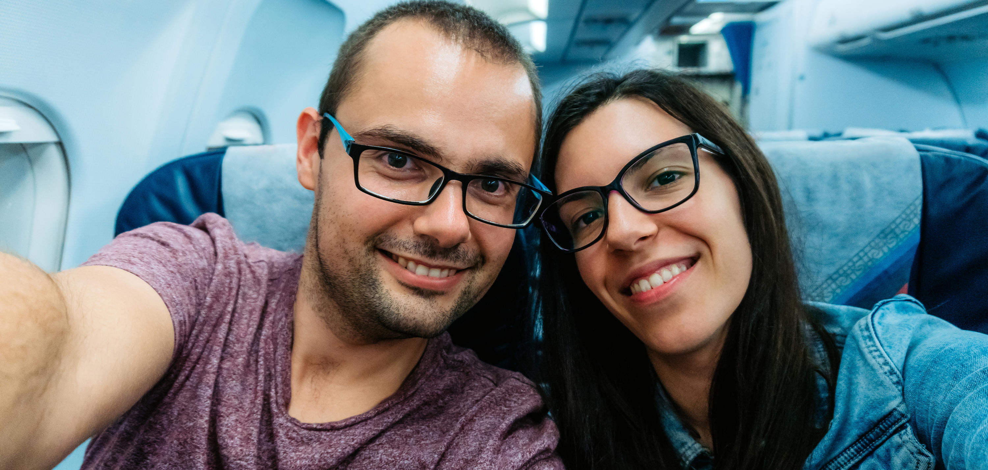
Air Operators - Cabin Safety

Slide 13
Cabin Safety Issues
TRAINING, CHECKING AND RECENCY
INFRASTRUCTURE AND EQUIPMENT
Skills and knowledge degradation due to lack of recent practice
Disinfection (biocides) effect on aircraft systems and structural components
Reduction in training effectiveness due to COVID-19 restrictions
MANAGEMENT SYSTEMS
Knowledge transfer missed for new generation aviation personnel
Prevention and treatment of unruly passengers in the context of COVID-19
Cabin crew now working for different airlines than before COVID-19 - mixed composition on flights
Contamination and Risk of Infection on Return to Work
Reduced focus on, or prioritisation of safety, human and organisational factors
HUMAN PERFORMANCE
Decreased wellbeing of aviation professionals during shutdown and on return to work
Carriage of hand sanitiser in the cabin
Aviation personnel fatigue
Reduced adherence to procedures in the new working environment
Unexpected team behaviours resulting from roster adaptations to the pandemic

Slide 14
Cabin Safety - General
Be flight ready (ID, passport with 6 months' validity, device software updates, check processes).
Passengers will likely be worried to fly as well – show them empathy as you reassure and support them while gently and firmly making sure that health safety matters are implemented.
Never compromise on safety, do things right - follow recognised processes, procedures and practices. (Specifically focus on doors familiarisation).
Use your organisation's reporting system and have open conversations about operational challenges.
Recognise and support crew who maybe adapting to a new and unusual working environment after a prolonged period away.

Slide 15
Cabin Safety - Pre-Departure
Ensure that you have thorough pre-departure briefings and engage with all crew briefings.
Ensure that you are mentally and physically prepared for the flight ahead.
Ensure that you are familiar with the procedures. Some of the procedures might have changed since your last flight.
Think about how you would handle specific situations (e.g. PED Fire, Passenger who Won't Wear a Mask etc).
Have human performance issues at the front of your mind such as distraction or interruption and apply appropriate Human Factors coping strategies.

Slide 16
Cabin Safety - In-Flight
Work together as a team to help and support each other throughout the flight.
Support your colleagues mental and physical wellbeing from start to finish.
Try to identify and deal with potentially disruptive passengers as early as possible.
Set the example to passengers with health protocols such as mask wearing.
Prepare the cabin for landing as early as possible.
Give yourself time to perform a silent review on how you would perform in case of an emergency.

Slide 17
Cabin Safety - Post Flight/ Layover
Take part in crew debriefs to see what lessons can be learned for future flights.
Reflect on your own performance and think about what you could do better next time.
Look after your own wellbeing during layovers - use the wellbeing coping strategies in the EASA Wellbeing Resource Hub.
Look after colleagues to get through the situation together.

Slide 18
Questions?

Slide 19
Come and join
the discussion !

