Slide 1
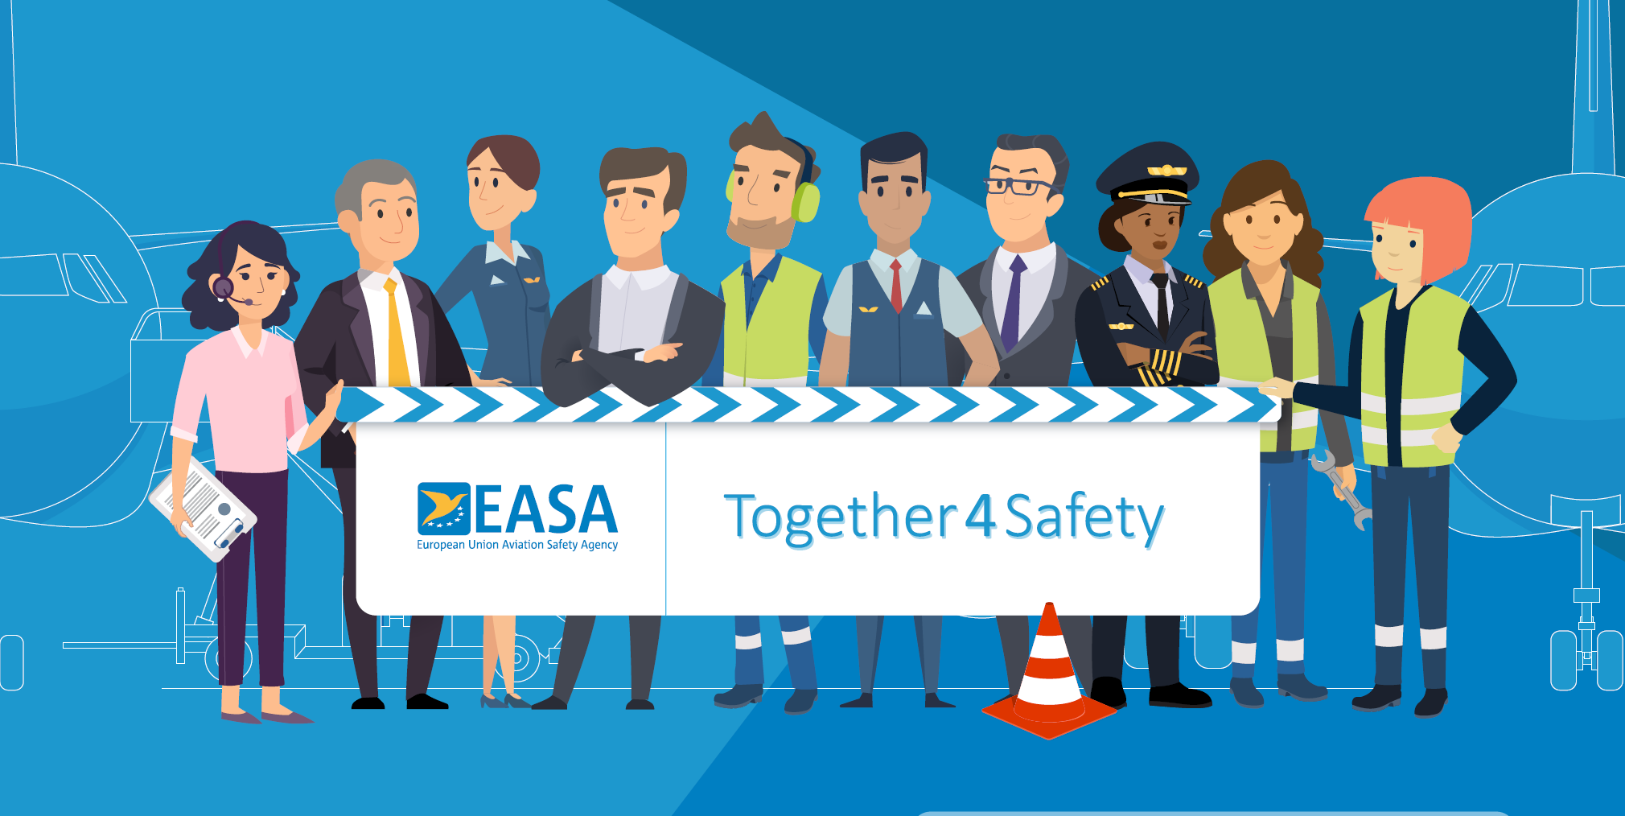
Stronger and Safer Together, Always

Slide 2
With Thanks to the Following Organisations Who Supported the Development of this Material
Human Factors Wellbeing Group

Slide 3
Campaign Supporters
Human Factors Wellbeing Group

Slide 4
Its purpose and what it stands for
""To provide useful information that engages people in positive conversations about safety so that the aviation community can deliver the safety capacity needed to ensure safe operations"
Collaborative
Useful and Supportive
We collaborate to understand the challenges industry are facing and work hard to help develop practical solutions.
We collaborate to understand the challenges industry are facing and work hard to help develop practical solutions.
Plain Speaking
Engaging
We use plain, simple language that seeks to provide the clarity people need to easily understand often complex information without talking down to them.
We start positive conversations about safety that gets people thinking and provide the tools and information industry needs.

Slide 5
The "Always" Campaign
Stronger, Safer, Together - Always
Safety is not a process or an outcome. It is the capacity of all stakeholders in the aviation system to collectively contribute to
safe and effective operations, every single day - always
The importance of a collaborative, industry-wide campaign
Aviation relies on all actors working in a coordinated and connected way.
We achieve more we align our core values and work together with common goals
We focus on key activities, actions and behaviours that are at the heart of safe operations

Slide 6
Be Ready, Stay Safe - Driving Safe Operations
Be Ready means
Stay Safe means
Having enough skilled, trained and qualified people who are operationally ready and fit for duty.
Ensuring that you have the right tools, equipment and infrastructure in place.
Defining and living by the values that creates the trust needed to support positive safety conversations.
Encouraging people to do things the right way by following the relevant processes, procedures and practices.
Knowing your risks and mitigating them effectively as part of a resilient management system.
Inspire your teams to talk about safety and then having a positive approach to learning and solving problems.

Slide 7
The Audience for the Campaign?
This package is for organisations and particularly for leaders and managers who are developing their own Ramp-up preparations.
Organisations should use this material to support a people-centred Ramp-up as it relates to their own operation (add your logo to the top right of the main powerpoint slides and go!)
It is designed to help staff representatives in supporting their organisations and colleagues during the Ramp-up.
This material is designed to align our ramp up approaches across the industry and to save you time when developing your own messages.

Slide 8
What is in the package?
Defining the campaign, its goals and values
What is "Be Ready" and "Stay Safe"
Examples of the key actions for each of the domain groups
Domain safety issues
Domain Ramp-up resources
Safety posters

Slide 9
What you can do with the material?
Go to the EASA Air Ops Community to get access to the Safety issues report and other Ramp-Up Resources.
Use the campaign material within your own organisations during the summer and beyond - the messages are for always.
Register for the domain discussions at the EASA Safety Week between 26-28 June (Register via the EASA Website)
Join the ongoing discussions with our Conversation Aviation webinars and on the LinkedIn Group.

Slide 10
Domain Based Actions and Behaviours
Flight Crew
Airport/ Ground Handling
ATM/ANS
Cabin Crew
Engineers

Slide 11
General Ramp-Up Resources
EASA - COVID-19 Resource Hub
IATA - COVID Resources
ACI - COVID Resources
CANSO - COVID-19 Restart and Recovery Guide
EASA - Review of Safety Issues Arising from the COVID-19 Pandemic
EASA - SAFE360° Conference 13-15 September 2022
EASA - Ramp-Up Safety Week 26-28 June 2022
EASA - Wellbeing Resource Hub
Regulation (EU 376/2014 on the Reporting, Analysis and Follow-Up of Occurrences
Just culture toolbox from ATCEUC, CANSO, ETF, IFAIMA, IFATCA & IFATSEA

Slide 12
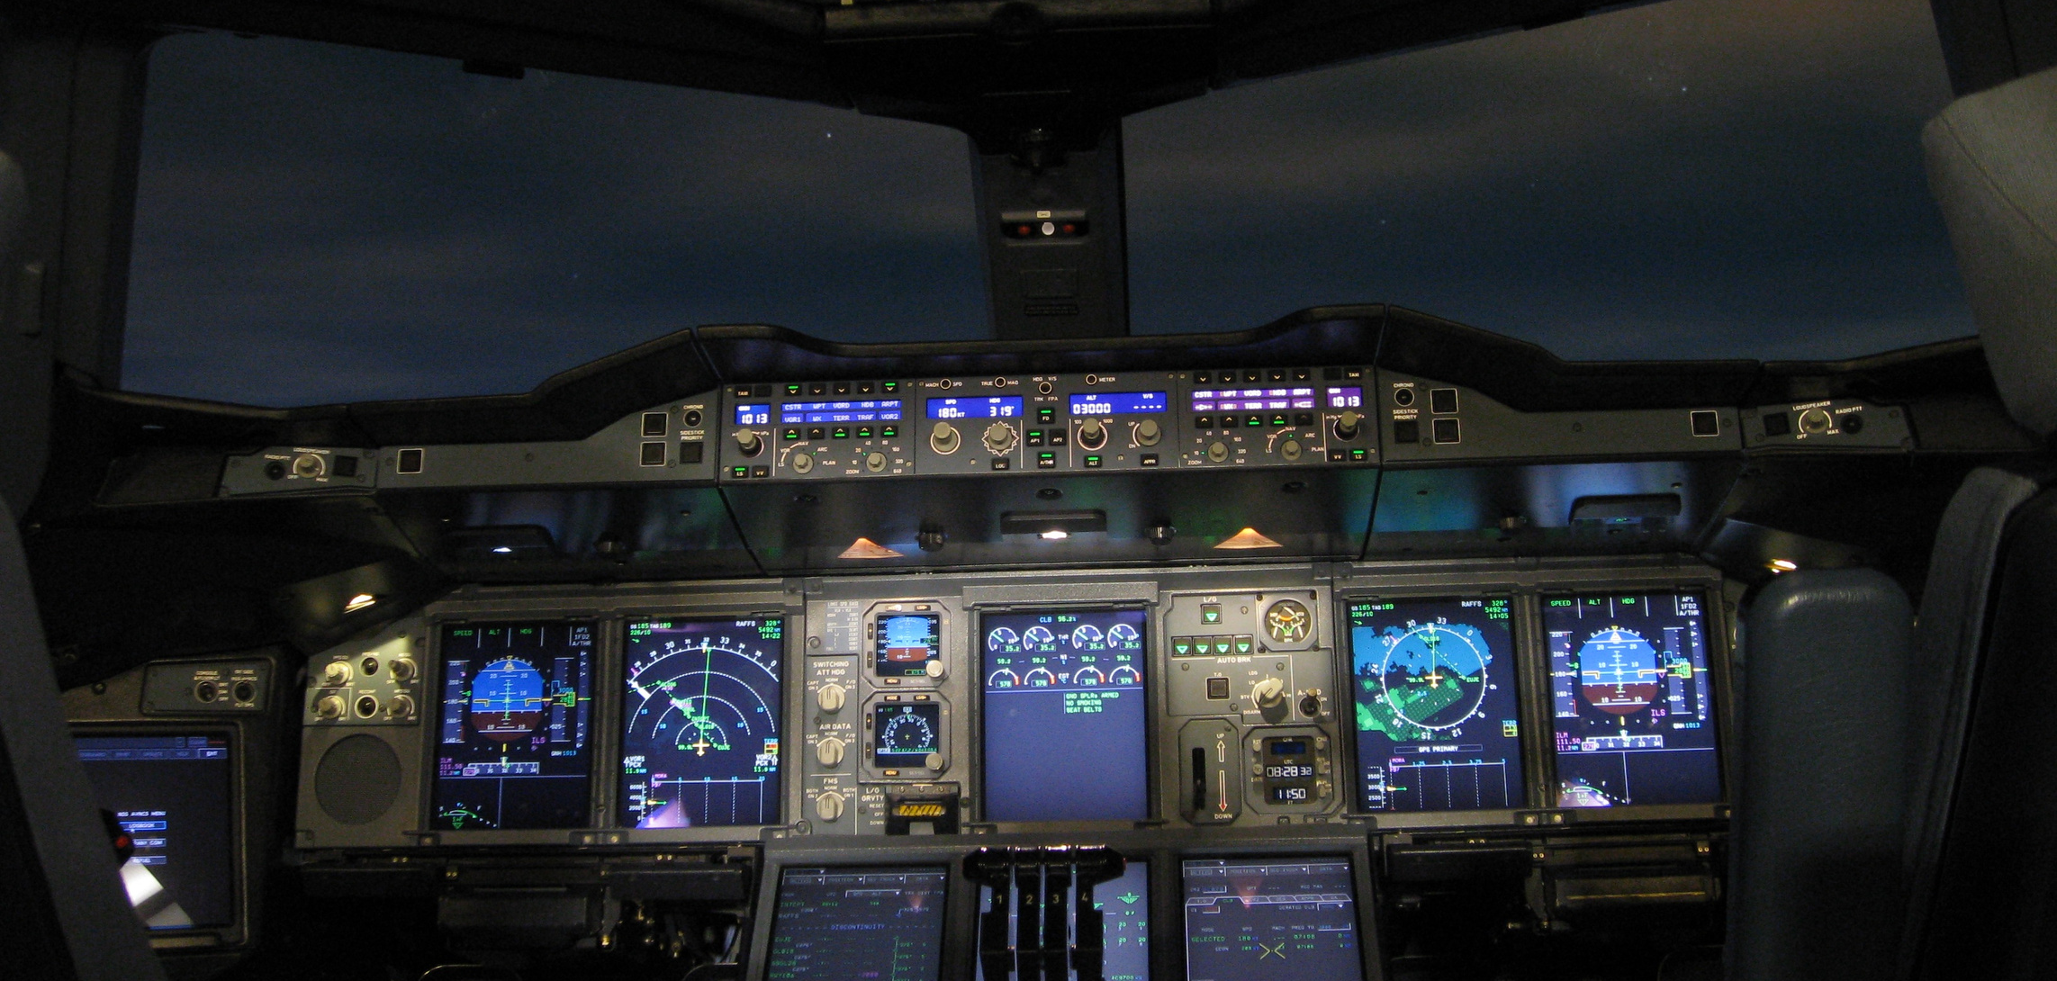
Air Operators

Slide 13
Air Operators - Safety Issues
TRAINING, CHECKING AND RECENCY
INFRASTRUCTURE AND EQUIPMENT
Skills and knowledge degradation due to lack of recent practice
Increased presence of wildlife on aerodromes
Transfer of pilots from one fleet to another resulting in low hours on type
Operational risks of aircraft storage at aerodromes
Postponement of emergency response plan exercises may lead to ineffective handling of emergencies
Reduction in training effectiveness due to COVID-19
Increased use of real aircraft for training instead of simulators
Ground Service Equipment may malfunction due to long periods of disuse and a lack of maintenance
Increased periods between licence/ validation checks
Flight simulator recurrent evaluations have been limited
Long gap in flying following type-rating training
MANAGEMENT SYSTEMS
HUMAN PERFORMANCE
Decreased wellbeing of aviation professionals during shutdown and on return to work
Reduced focus on, or prioritisation of safety, human and organisational factors
Roster adaptations to reduce transmission of illness may create different team behaviours
Risk assessments based on previous normal operations are no longer valid
Reduced adherence to procedures in the new working environment
Application of COVID-19 health control measures may negatively affect operations
Flight crew fatigue due to unavailability of rest facilities at destination or extended duty period
Extent and duration of COVID-19 exemptions and temporary rules
Unusual approach profiles in the circumstances of the pandemic (unstable approaches)

Slide 14
Air Ops - General
You may be rusty so review SOPs and Emergency Recall Items before reporting for duty.
Read all checklists slowly and deliberately in accordance with SOPs.
Ensure the crew is aware and “in the loop”. Question when unsure.
Carefully consider short cuts before accepting during all flight phases.
Be ready for unexpected technical failures due to long storage of aircraft.
Rushing is never a good idea. Especially now. Take your time to properly perform your tasks. Do not rush the crew in the cabin.

Slide 15
Air Ops - Preparation
There needs to be a thorough pre-flight briefing with Cabin Crew to ensure a common understanding of procedures, timings, need to support and monitor each other.
Flight Deck Briefing - verbalise the plan and pay attention to the HOW (How are you going to fly it?)
Ensure a proper briefing stating all threats and how you mitigate them.
Take your time for cross-checking the loaded route with the given clearance and charts.

Slide 16
Air Ops - Pushback
Ensure both pilots are listening on the radio for departure and pushback clearence.
When in doubt or unsure, stop and verify.
Ensure a clear communication with the ground crew.
Ensure a proper look out during pushback.

Slide 17
Air Ops - Taxi
Confirmation of taxi routing with pilot monitoring before aircraft moves.
Do not try to rush to comply with intersection departures.
Taxi slowly, be prepared for non-standard routings and parking on non-standard stands.
Only perform one engine taxi out if time and workload allows.

Slide 18
Air Ops - Take-Off/ Departure
Do not get distracted by ATC.
Monitor climb rates when light (use of v/s).
Do not push for short cuts (consider implications).
No high speed below FL100.
Strictly adhere to the sterile cockpit concept below FL100.

Slide 19
Air Ops - Cruise
Delay paperwork until you are at cruise level.
Fly the plan in relation to FL and managed spped. Only deviate at ATC request.
Ensure you stay hydrated and you eat enough.
Pay more attention to the aircraft and the flight path then you were used to, it has been a long time and unfamiliarisation will work against you.
As pilot monitoring make sure you are monitoring and helping the pilot flying during cruise as well.
Carefully consider short cuts before accepting.

Slide 20
Air Ops - Descent/ Approach
Ensure a thorough briefing including threats and how to mitigate them. Consider new NOTAMs that may contain nonstandard elements, weather, aircraft defects etc.
PM: Close monitoring of track miles and descent profile.
Maintain good awareness of terrain MSAs and MRC plates.
Maximum use of the highest levels of automation.
Slow down earlier, configure a little bit earlier.
Maintain strict compliance with noise and environmental corridors.
Consider that the cabin crew may require a bit more time to be ready.

Slide 21
Air Ops - Taxi In
Again, take your time to complete your procedures.
Avoid single engine taxiing during increased workload.
Brief and/or verify cleared taxi route to parking position.
Do not rush taxiing to the parking position.

Slide 22
Air Ops - Post Flight
Discuss any occurrences or moments in the flight that could be improved and why.
Take your time to finish the paperwork.
Leave the cockpit the way you would like to have it when you walk into the cockpit.
Even though it may take extra time, file a safety report or hazard report when applicable. You are an essential part in ensuring a safe operation for the whole company
Make sure you ask your collegues, including cabin crew and ground staff, how the flight was and how they are before saying thank you and goodbye.

Slide 23
Questions?

Slide 24
Come and join
the discussion !

