Slide 1



Stronger and Safer Together, Always

Slide 2

















With Thanks to the Following Organisations Who Supported the Development of this Material
Human Factors Wellbeing Group

Slide 3



Campaign Supporters
Human Factors Wellbeing Group

Slide 4
Its purpose and what it stands for
""To provide useful information that engages people in positive conversations about safety so that the aviation community can deliver the safety capacity needed to ensure safe operations"
Collaborative
Useful and Supportive
We collaborate to understand the challenges industry are facing and work hard to help develop practical solutions.
We collaborate to understand the challenges industry are facing and work hard to help develop practical solutions.
Plain Speaking
Engaging
We use plain, simple language that seeks to provide the clarity people need to easily understand often complex information without talking down to them.
We start positive conversations about safety that gets people thinking and provide the tools and information industry needs.

Slide 5



The "Always" Campaign
Stronger, Safer, Together - Always
Safety is not a process or an outcome. It is the capacity of all stakeholders in the aviation system to collectively contribute to
safe and effective operations, every single day - always
The importance of a collaborative, industry-wide campaign
Aviation relies on all actors working in a coordinated and connected way.
We achieve more we align our core values and work together with common goals
We focus on key activities, actions and behaviours that are at the heart of safe operations

Slide 6
Be Ready, Stay Safe - Driving Safe Operations
Be Ready means
Stay Safe means
Having enough skilled, trained and qualified people who are operationally ready and fit for duty.
Ensuring that you have the right tools, equipment and infrastructure in place.
Defining and living by the values that creates the trust needed to support positive safety conversations.
Encouraging people to do things the right way by following the relevant processes, procedures and practices.
Knowing your risks and mitigating them effectively as part of a resilient management system.
Inspire your teams to talk about safety and then having a positive approach to learning and solving problems.

Slide 7

The Audience for the Campaign?
This package is for organisations and particularly for leaders and managers who are developing their own Ramp-up preparations.
Organisations should use this material to support a people-centred Ramp-up as it relates to their own operation (add your logo to the top right of the main powerpoint slides and go!)
It is designed to help staff representatives in supporting their organisations and colleagues during the Ramp-up.
This material is designed to align our ramp up approaches across the industry and to save you time when developing your own messages.

Slide 8

What is in the package?
Defining the campaign, its goals and values
What is "Be Ready" and "Stay Safe"
Examples of the key actions for each of the domain groups
Domain safety issues
Domain Ramp-up resources
Safety posters

Slide 9

What you can do with the material?
Go to the EASA Air Ops Community to get access to the Safety issues report and other Ramp-Up Resources.
Use the campaign material within your own organisations during the summer and beyond - the messages are for always.
Register for the domain discussions at the EASA Safety Week between 26-28 June (Register via the EASA Website)
Join the ongoing discussions with our Conversation Aviation webinars and on the LinkedIn Group.

Slide 10

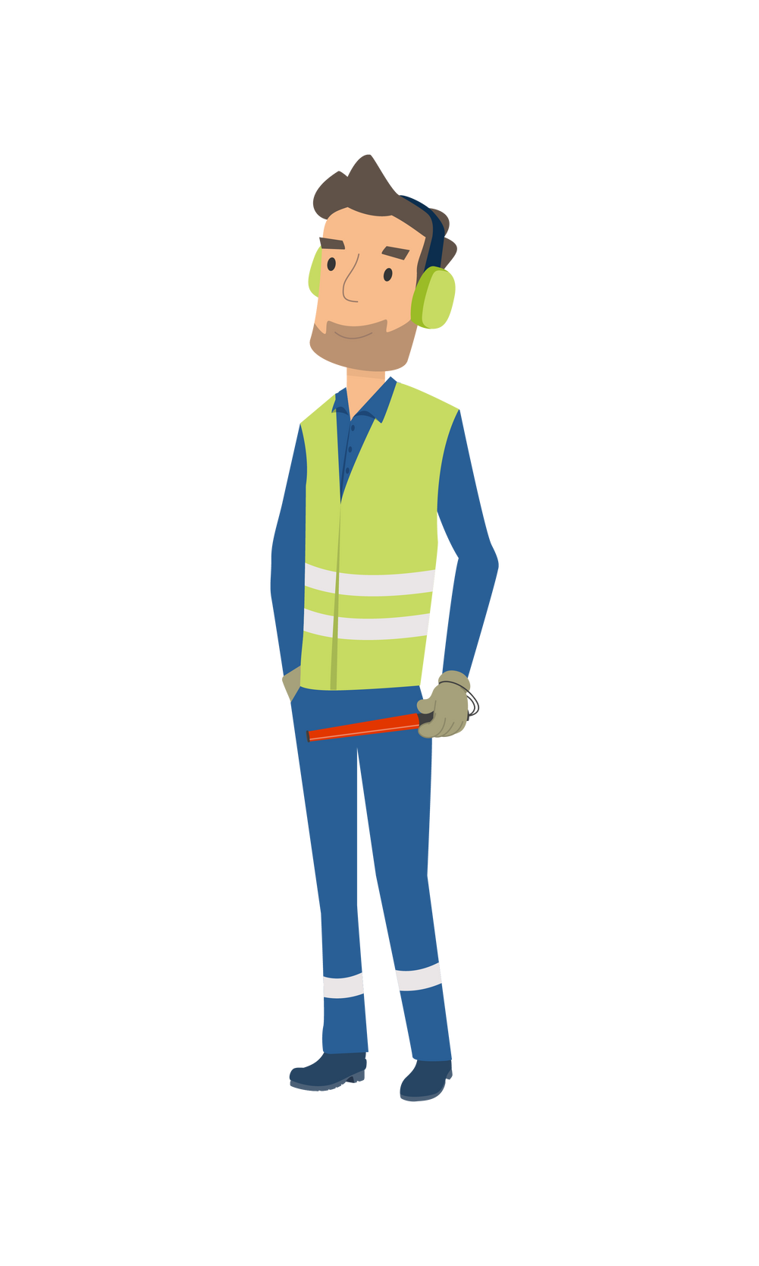



Domain Based Actions and Behaviours
Flight Crew
Airport/ Ground Handling
ATM/ANS
Cabin Crew
Engineers

Slide 11


General Ramp-Up Resources
EASA - COVID-19 Resource Hub
IATA - COVID Resources
ACI - COVID Resources
CANSO - COVID-19 Restart and Recovery Guide
EASA - Review of Safety Issues Arising from the COVID-19 Pandemic
EASA - SAFE360° Conference 13-15 September 2022
EASA - Ramp-Up Safety Week 26-28 June 2022
EASA - Wellbeing Resource Hub
Regulation (EU 376/2014 on the Reporting, Analysis and Follow-Up of Occurrences
Just culture toolbox from ATCEUC, CANSO, ETF, IFAIMA, IFATCA & IFATSEA

Slide 12
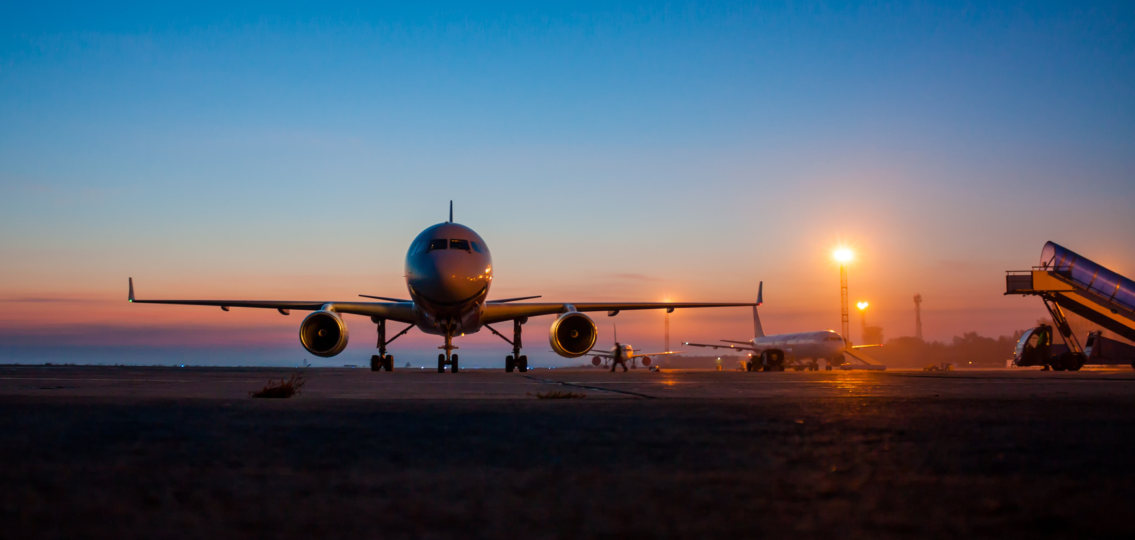
Domain Packages

Slide 13

Aerodromes

Slide 14

Aerodrome Safety Issues
INFRASTRUCTURE AND EQUIPMENT
MANAGEMENT SYSTEMS
Airside works
Apron management
Aerodrome emergency plan
Electrical power supply systems
Aeronautical information management
Ground Service Equipment
Application of COVID-19 health measures
Inspection of Paved and Unpaved Surfaces
Contamination and Risk of Infection on Return to Work
Non-visual aids for navigation
Coordination and collaboration
Obstacle Management
Disabled aircraft removal plan
Rescue and firefighting
Low visibility procedures (LVP)
Technical issues relating to recommencing use of aircraft fuelling after a long break
Operational risks of aircraft storage at aerodromes
Vehicle/equipment readiness
Operations in winter conditions
Visual aids for navigation
Reduced focus on safety
Widlife hazard management

Slide 15
Aerodrome Safety Issues
TRAINING, CHECKING AND RECENCY
HUMAN PERFORMANCE
Availability and competence of personnel
Aviation personnel fatigue
Skills and knowledge degradation due to lack of recent practice
Decreased wellbeing of aviation professionals
Ground handling staff training programme disruption and reduction in training effectiveness
Impact of the pandemic on the ground handling industry – human factors
Knowledge transfer missed for new generation aviation personnel
Reduced adherence to procedures in the new working environment
Reduction in training effectiveness due to COVID-19 restrictions
Roster adaptations to reduce transmission of illness may create different team behaviours

Slide 16
Safety Information - COVID-19 Safety Risk Portfolio
The newly published review contains links to guidance material regarding safety mitigating actions, including for aerodromes and ground handling.
Infrastructure and Equipment
Training, Checking and Recency
Management Systems
Human Performance
Financial Impacts on Safety
Outdated Information;

Slide 17
Aerodromes Safety Issues (SIB 2020-07R1)
Published 21 January 2021
Surfaces
Emergency Plan
Electrical Power Supply
Vehicles/ Equipment
Visual/ Non-Visual Aids
Disabled Aircraft
Rescue and Fire-Fighting
Competency of Staff
Obstacle Management
Coordination
Wildlife Management
Low Visibility Procedures
Apron Management
Winter Conditions
Aeronautical Info Management
Management Systems

Slide 18
Ground handling Safety Issues (SIB 2020-13)
Published 29 July 2020
Financial Impacts
Unused Ground Services Equipment (GSE)
Return-to-Operations Plan
Maintenance of Equipment
Refresher Training
Authorisation for Vehicle Drivers
Training of New Personnel
Staff Wellbeing

Slide 19
Aerodromes - General
PPE is there to protect you and your colleagues. Wear it, don’t lose it!
If you see something, say something. Report it don’t ignore it!
Be deliberate and knowledgable in your actions and be mindful of the consequences of any errors made.
Be wary of yours and your colleagues rustiness/fatigue due to reduced work activity/working hours/furlough.
Be understanding of colleagues and be prepared to challenge any unintended or deliberate deviations from safety standards.

Slide 20
Aerodromes - Before/ During a Task
Ensure that you have thorough pre-task briefings and consider if you have the people needed for the task who have the knowledge/ training needed and are mentally and physically prepared.
Ensure you have and use the approved data, tools, equipment and resources for the task.
Take the appropriate safety precautions and follow all regulations and procedures.
Have human performance issues at the front of your mind and apply appropriate Human Factors coping strategies.
Reiterate the expected standards with your team prior to commencing work - remember you uphold the standards

Slide 21
Aerodromes - After the Task
Debrief post work to evaluate how the job went to see what you can learn and improve for next time.
Ensure that you use all the approved data, methods and practices.
Complete all paperwork correctly prior to the next flight.

Slide 22
Aerodromes - Task Specific - Ground Handling
Be prepared and plan ahead. Turn up at the right time prior to aircraft arrival.
Make sure to label defective equipment.
Keep calm and carry on safely.
Only carry out tasks using the correct equipment for the job.
Always remain vigilant and alert.

Slide 23
Aerodromes - Task Specific - Aerodrome
Passport & PCR checks; Do it once, Do it right.
Beware of Lithium-ion battery restrictions, one too many can cause fire.
Don’t rush cabin cleaning, thoroughly clean, prevent the spread.

Slide 24
Aerodromes - Task Specific - Cargo
Congested warehouse? Be aware of forklifts and people around you.
Cargo overhanging racking can fall and kill – don’t wait for someone else to put it right.

Slide 25
Questions?

Slide 26
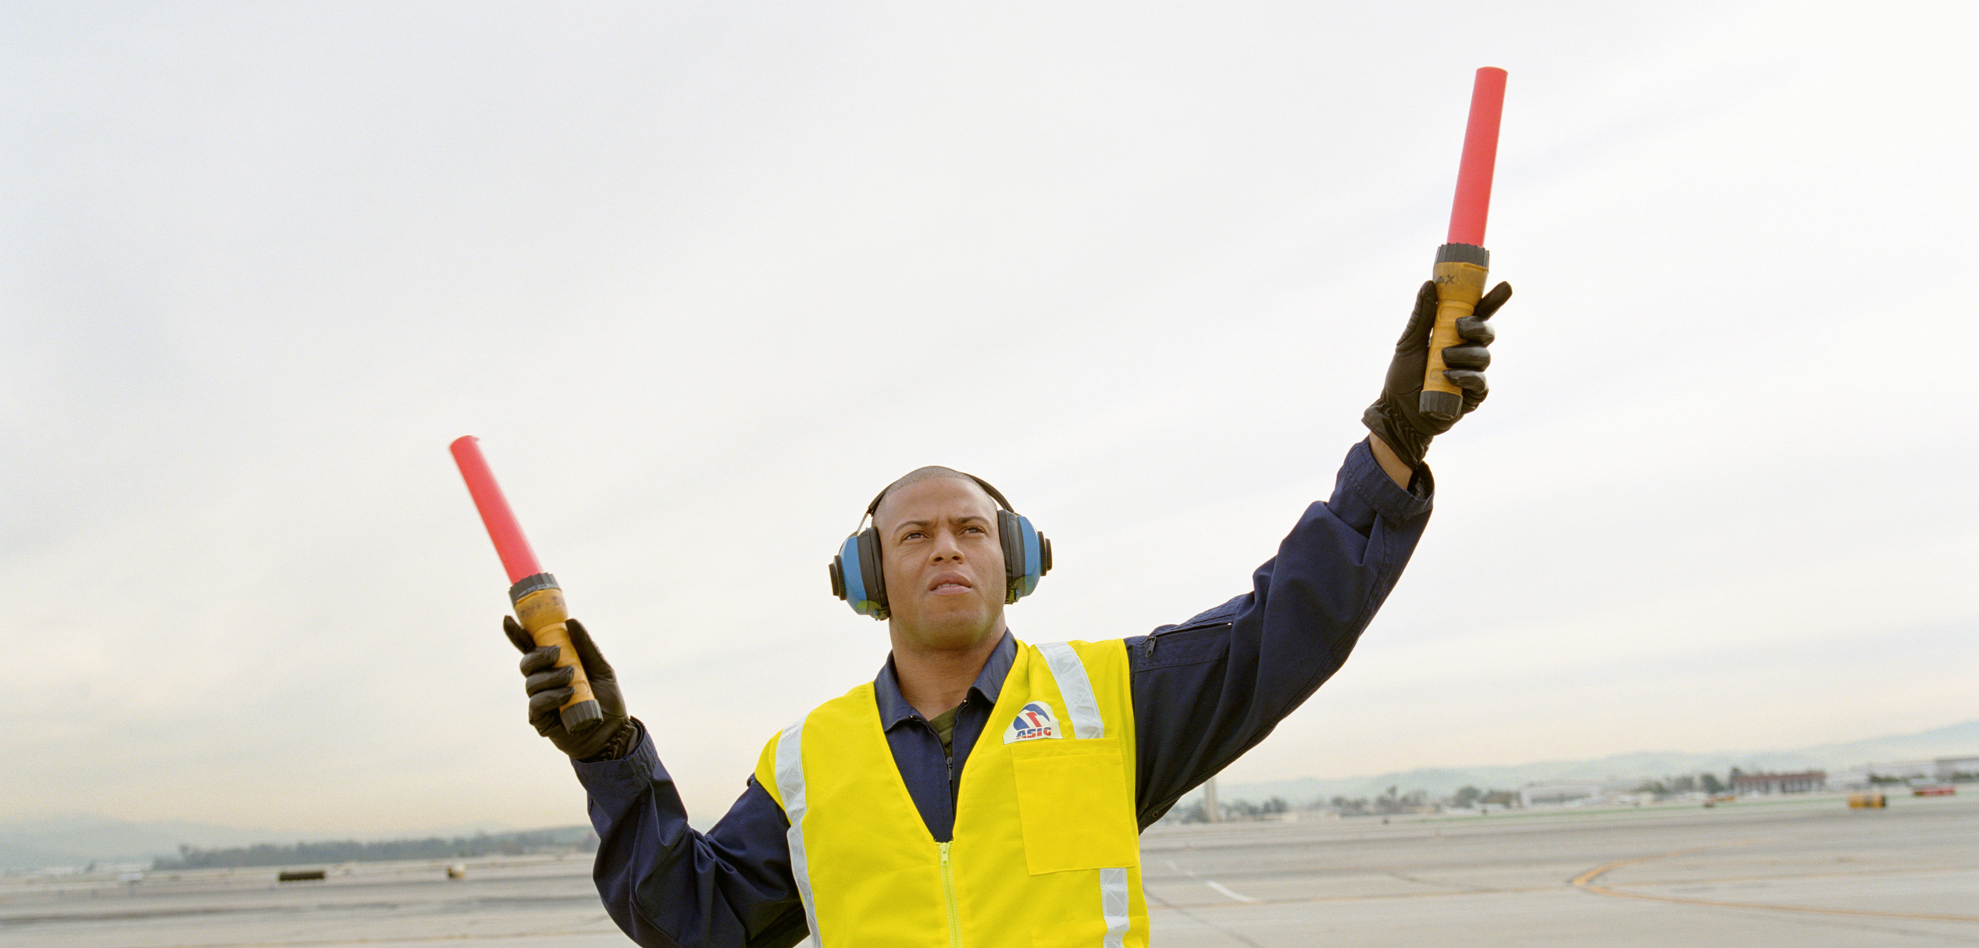
Come and join
the discussion !

