Slide 1



Be Ready - Stay Safe

Slide 2
Be Ready - Stay Safe

Slide 3
















With Thanks to the Following Organisations Who Supported the Development of this Material
Human Factors Wellbeing Group

Slide 4

Who is this package of material for?
  This package is for organisations and particularly for leaders and managers who are developing their own Ramp-up preparations.
  Organisations should use this material to support a people-centred Ramp-up as it relates to their own operation (add your logo to the top right of the main powerpoint slides and go!)
  It is designed to help staff representatives in supporting their organisations and colleagues during the Ramp-up.
  This material is designed to align our ramp up approaches across the industry and to save you time when developing your own messages.

Slide 5

What is in the package?
  Organisational definition of "Be Ready" and "Stay Safe"
  Key messages for aviation personnel during the Ramp-up
  Examples of the key actions for each of the domain groups
  Domain safety issues
  Domain Ramp-up resources

Slide 6



Be Ready - Stay Safe: For Organisations
The importance of an industry-wide campaign
Be Ready means
Ensuring that you have the right tools, equipment and infrastructure in place.
Having enough skilled, trained and qualified people who are operationally ready and fit for duty.
Putting your staff and their wellbeing at the heart of a people centred ramp-up.
Aviation services are interconnected and rely upon organisations working together seamlessly.
Stay Safe means
Start-up strategies need to be addressed by all organisations to ensure the safe delivery of services.
Encouraging people to follow recognised processes, procedures and practices.
Knowing your risks and mitigating them effectively as part of a resilient management system.
Setting a culture of trust that encourages reporting and for people to talk openly about safety and wellbeing.
We all need to focus on key behaviours during the ramp-up of operations over the coming months.

Slide 7

Be Ready - Stay Safe: For Individuals
Right
Do everything the right way - follow processes, procedures and practices.
Speak-up
If you have any concerns about something you see or experience, speak up.
Engaged
Talk about safety and use the reporting system of your organisation or confidential reporting, if you need to.
Actions
Be deliberate with your actions and maintain focus, try to minimise distractions.
Aware
Be aware that you and your colleagues may not be as recent or proficient as you might think.
Familiar
Take your time, things might not be as familiar as they were - plan ahead and prioritise your key work tasks.
Decisions
Be conscious about the decisions you make and review them regularly to see how you can improve.
Every day
Be prepared every day for new things – pay particular attention when doing something you haven't done for a while.
Yourself
and others
These are challenging times, so think about your wellbeing, that of your colleagues and others you interact with.

Slide 8
Be Ready - Stay Safe: Personnel Readiness
  Check all licences, medicals and other administrative details are all in date and ready to go.
  Review your Standard Operating Procedures (SOPs) and any emergency recall items prior to reporting for duty.
  Take some time to familiarise yourself with changes in your working environment.
  Prepare yourself mentally and physically by using the resources in the Wellbeing Hub.

Slide 9
Be Ready - Stay Safe: Leadership Actions
1
Leadership and culture
2
Communications
3
Policy and procedures
  Set a positive example for others to follow. Ensure that your actions are in line with organisational processes and policies.
  Establish a culture of trust that encourages engagement with staff at all levels so that its normal to report, provide feedback and discuss the challenges people face during the Ramp up to facilitate safety learning.
  Show management commitment to the wellbeing of staff and the values needed to be part of a safe and effective organisation.
  Identify where safety and business priorities might conflict and make deliberate decisions to prioritise safety first - include contingency for OTP erosion, disruptions, errors, planning failures.
  Plan a back to work communications strategy.
  Identify key messages and prioritise how, when, who and what you would like people to do?
  Show visible leadership when you communicate.
  Create scripts for each layer of management, all aligned on same theme - elevator pitch for each and every staff engagement.
  Emphasise systemic nature of challenge - need to embrace partners and airport community in communications.
  Communicate about your reporting system and confidential reporting processes under Reg 376/2014
  Ensure that all procedures/ manuals are up to date and that they are applicable to current COVID recovery situation.
  Encourage staff to follow rules, procedures and normal practices at all times.
  Consider the specific health safety measures needed to keep people safe from COVID in all roles (operational and non-operational).
  Review, update and improve the Wellbeing policy within your organisation to help support the mental and physical health of staff.

Slide 10
Be Ready - Stay Safe: Leadership Actions
4
People and Wellbeing
5
Skills and Training
6
Resources and Equipment
  Support your staff to be fit for duty - especially in the context of skill fade, fatigue, wellbeing.
  Encourage staff to look after themselves by asking "How am I feeling", "How am I coping", "What can I do for myself and others" and by looking after yourself (Wellbeing Resource Hub)
  Encourage staff to support each other by continually reaching out to each other to offer support - especially important when down route.
  Encourage staff to seek help through medical professionals or peer support networks and ensure this is part of your organisational culture.
  Think about how your staff's skills and knowledge may have been degraded during the pandemic and what this means when activities increase.
  Identify situations where you might be using staff in new ways, locations or situations and what this means for your operation.
  Identify additional training you might wish to provide that you might have considered before COVID such as "Return to Work" training or Wellbeing.
  Consider leadership training for executive team, to highlight need for visible, supportive leadership. "All in this together" needs to be lived.
  Verify that enough competent and suitably trained staff are available to perform all key activities and think about how teams are composed.
  Verify that vehicles and ground servicing equipment are available to perform all key activities.
  Verify that appropriate facilities, buildings and services are available to perform all key activities.
  Consider over-provision of Covid-19 PPE and other supplies, to minimise any related stressors during Ramp up.

Slide 11
Be Ready - Stay Safe: Leadership Actions
7
Management Systems
8
Third Party Providers
  Utilise your management system to effectively manage safety in your actual day-to-day operation - the situation is dynamic so be aware of changes.
  Know your risks, mitigate them continously and properly - use the EASA COVID-19 Risk Portfolio to help you.
  Encourage people to report occurrences and hazards and be prepared to investigate them - with appropraite feedback throughout the organisation.
  Ensure you are able to turn your data into intelligence that you can then talk about and use to manage the risks in your organisation.
  Ensure that Cyber, Security and Wellbeing are included in your management system.
  Consider pro-active seeking of operational feedback - use a "pull" campaign rather than relying on voluntary submission of reports. No reports doesn't necessarily mean no issues.
  Don’t assume that all third party providers are in the same situation as you are or where they were before the pandemic - reach out and engage with them.
  Verify the status of any new service providers or companies that you plan to contract.
  Check that suppliers/ providers are not taking short cuts to keep afloat, your success depends on them - reach out and offer support.

Slide 12

Be Ready - Stay Safe: Support Teams
1
General
2
Email
3
Meetings
4
Communication
Create some headspace by putting key priorities in your diary up to 4 weeks ahead and create distraction-free moments.
Create times when you are able to disconnect from work.
Think about your own wellbeing and take care of those around you.
Schedule time in your diary to do email so that it doesn't take over your day.
If you send an email be clear about the purpose and what you would actually like people to do.
Don't leave colleagues waiting for a long time for a reply, send at least a holding reply.
Minimise use of CC. Does that person really need to be made aware? Why not include them in direct email?
Think about who you invite to a meeting so that everyone is clear on the need for their time.
Use the scheduling assistant to check that people are free.
Avoid back to back online meetings by planning 45 minute meetings instead of an hour.
Avoid scheduling meetings outside normal office hours, keeping time zones in mind - consider local time lunch breaks as well.
Don't just communicate via email, pick up the phone, video call or even in person if possible.
Reach out to colleagues across Teams etc whenever possible.
Don't just do the work, communicate that it is done to people who need to know.
Consider outdoor walking meetings if feasible. Try to schedule walking or stand-up meetings to break up the day

Slide 13


General Ramp-Up Resources
EASA - COVID-19 Resource Hub
IATA - COVID Resources
ACI - COVID Resources
CANSO - COVID-19 Restart and Recovery Guide
EASA - Review of Safety Issues Arising from the COVID-19 Pandemic
EASA - SAFE360° Conference 8-10 June 2021
EASA - Ramp-Up Safety Week 21-24 June 2021
EASA - Wellbeing Resource Hub
Regulation (EU 376/2014 on the Reporting, Analysis and Follow-Up of Occurrences
Just culture toolbox from ATCEUC, CANSO, ETF, IFAIMA, IFATCA & IFATSEA

Slide 14

Post COVID-19 Ramp-Up Safety Week - 21-24 June 2021
Mon 21 June
(1400-1530)
Top Safety
Issues
Tue 22 June
(1000-1130)
ATM/ANS
Providers
Tue 22 June
(1400-1530)
Aerodrome Operators
Wed 23 June
(1000-1130)
Training Organisations
Wed 23 June
(1400-1530)
Air
Operators
Thu 24 June
(1000-1130)
Maintenance Organisations
Thu 24 June
(1400-1530)
Get Ready
Be Safe
Introduction to Safety Week
Top Safety Issues
Resources/Actions
Top Safety Issues
Resources/Actions
Top Safety Issues
Resources/Actions
Top Safety Issues
Resources/Actions
Top Safety Issues
Resources/Actions
Summary of
Safety Week
Top Safety Issues from Analysis
Helping Staff Return to Work
Safety
Leadership
Maintaining Controller Skills and Knowledge
Ramping Up Operations & Managing Skills and Knowledge
Managing Safety and Competence in Operations
Crew Skills and Knowledge
Be Ready, Stay Safe Actions
Returning Aircraft to Service
Talking About Safety

Slide 15

Aerodromes

Slide 16

Aerodrome Safety Issues
INFRASTRUCTURE AND EQUIPMENT
MANAGEMENT SYSTEMS
Airside works
Apron management
Aerodrome emergency plan
Electrical power supply systems
Aeronautical information management
Ground Service Equipment
Application of COVID-19 health measures
Inspection of Paved and Unpaved Surfaces
Contamination and Risk of Infection on Return to Work
Non-visual aids for navigation
Coordination and collaboration
Obstacle Management
Disabled aircraft removal plan
Rescue and firefighting
Low visibility procedures (LVP)
Technical issues relating to recommencing use of aircraft fuelling after a long break
Operational risks of aircraft storage at aerodromes
Vehicle/equipment readiness
Operations in winter conditions
Visual aids for navigation
Reduced focus on safety
Widlife hazard management

Slide 17
Aerodrome Safety Issues
TRAINING, CHECKING AND RECENCY
HUMAN PERFORMANCE
Availability and competence of personnel
Aviation personnel fatigue
Skills and knowledge degradation due to lack of recent practice
Decreased wellbeing of aviation professionals
Ground handling staff training programme disruption and reduction in training effectiveness
Impact of the pandemic on the ground handling industry – human factors
Knowledge transfer missed for new generation aviation personnel
Reduced adherence to procedures in the new working environment
Reduction in training effectiveness due to COVID-19 restrictions
Roster adaptations to reduce transmission of illness may create different team behaviours

Slide 18
Safety Information - COVID-19 Safety Risk Portfolio
The newly published review contains links to guidance material regarding safety mitigating actions, including for aerodromes and ground handling.
Infrastructure and Equipment
Training, Checking and Recency
Management Systems
Human Performance
Financial Impacts on Safety
Outdated Information;

Slide 19
Aerodromes Safety Issues (SIB 2020-07R1)
Published 21 January 2021
Surfaces
Emergency Plan
Electrical Power Supply
Vehicles/ Equipment
Visual/ Non-Visual Aids
Disabled Aircraft
Rescue and Fire-Fighting
Competency of Staff
Obstacle Management
Coordination
Wildlife Management
Low Visibility Procedures
Apron Management
Winter Conditions
Aeronautical Info Management
Management Systems

Slide 20
Ground handling Safety Issues (SIB 2020-13)
Published 29 July 2020
Financial Impacts
Unused Ground Services Equipment (GSE)
Return-to-Operations Plan
Maintenance of Equipment
Refresher Training
Authorisation for Vehicle Drivers
Training of New Personnel
Staff Wellbeing

Slide 21
Aerodrome Ramp-Up Resources
EASA - SIB 2020-07R2 Progressive Restart of Aerodrome Operations after Complete or Partial Closure
EASA - SIB 2020-13 : Provision of Groundhandling Services at Aerodromes
EASA - Review of Safety Issues Arising from the COVID-19 Pandemic
EASA - Maintaining the Focus on Safety During the COVID-19 Pandemic
EASA - SAFE360° Conference 8-10 June 2021
EASA/ECDC - Aviation Health Safety Protocol
EASA - Wellbeing Resource Hub
ACI - Airport COVID-19 Resources Hub
IATA - Ground Handling Return to Service
IATA - Guidance for Ground Handling During COVID-19

Slide 22
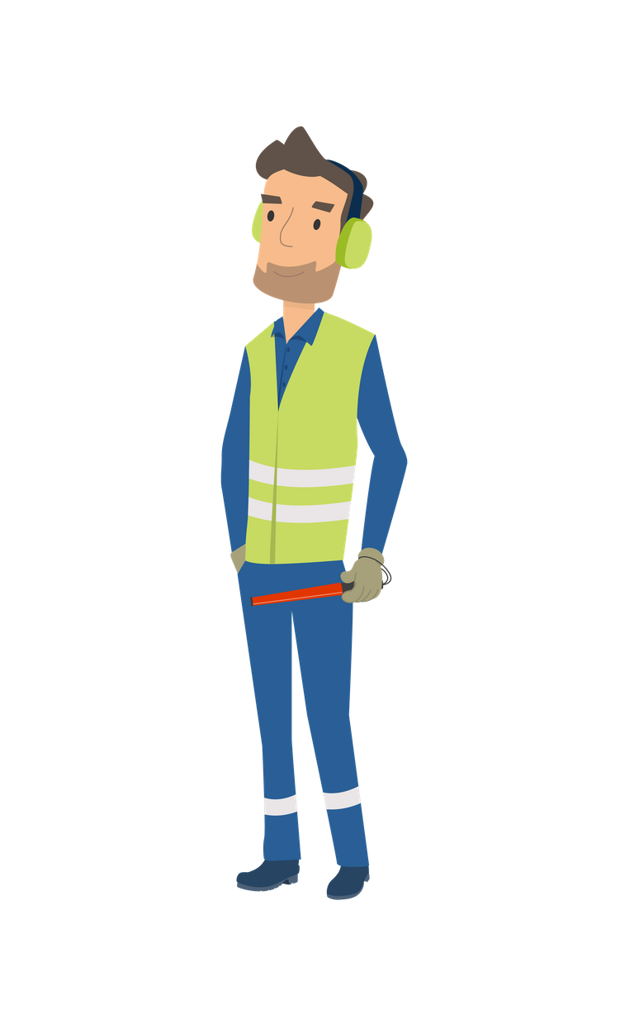
Be Ready - Stay Safe: Aerodromes - 1
1
General
2
Before/ During a Task
3
After the Task
  PPE is there to protect you and your colleagues. Wear it, don’t lose it!
  If you see something, say something. Report it don’t ignore it!
  Be deliberate and knowledgable in your actions and be mindful of the consequences of any errors made.
  Be wary of yours and your colleagues rustiness/fatigue due to reduced work activity/working hours/furlough.
  Be understanding of colleagues and be prepared to challenge any unintended or deliberate deviations from safety standards.
  Ensure that you have thorough pre-task briefings.
  Consider if you have the knowledge and training needed to perform the task.
  Ensure that you are mentally and physically prepared.
  Ensure you have and use the approved data, tools, equipment and resources for the task.
  Take the appropriate safety precautions and follow all regulations and procedures.
  Have human performance issues at the front of your mind and apply appropriate Human Factors coping strategies.
  Reiterate the expected standards with your team prior to commencing work - remember you uphold the standards
  Debrief post work to evaluate how the job went to see what you can learn and improve for next time.
  Ensure that you use all the approved data, methods and practices.
  Complete all paperwork correctly prior to the next flight.

Slide 23
Be Ready - Stay Safe: Aerodromes - 2
Task Specific - Ground Handling
Task Specific - Aerodrome
Task Specific - Cargo
4
5
6
  Be prepared and plan ahead. Turn up at the right time prior to aircraft arrival.
  Make sure to label defective equipment.
  Keep calm and carry on safely.
  Only carry out tasks using the correct equipment for the job.
  Always remain vigilant and alert.
  Passport & PCR checks; Do it once, Do it right.
  Beware of Lithium-ion battery restrictions, one too many can cause fire.
  Don’t rush cabin cleaning, thoroughly clean, prevent the spread.
  Congested warehouse? Be aware of forklifts and people around you.
  Cargo overhanging racking can fall and kill – don’t wait for someone else to put it right.

Slide 24
Questions?

