Slide 1
Ramp Resource Management Training
Version 1.0
Teamwork

Slide 2
Topics
Safety regulations
Teamwork
  Team dynamics
  Leadership
  Communication
  Team situational awareness
  Cultural, ethnic and educational differences
Threat and error management
Human performance
  Stress
  Fatigue
  Alcohol, medicines and drugs

Slide 3

Teamwork - leadership
Notes:
Interteam and intrateam cooperation
http://www.dutchtrainingprofessionals.nl/favoriete-filmpjes/groepsdynamiek-/-flashmobs-/-teamwork

Slide 4
Teamwork – team dynamics
`There was a team with four team members: Everybody, Somebody, Anybody and Nobody. There was an important job to so and Everybody was asked to do it. Everybody was sure Somebody would do it. Anybody could have done it, but Nobody did.
Everybody was angry about this, because it was Somebody’s job. Everybody thought Anybody could do it, but Nobody realised that Everybody wouldn’t. In the end, Everybody blamed Somebody when Nobody did what Anybody could have done.’

Slide 5
Teamwork – team dynamics
The Effective Group
Trust (First time) meeting
  (Acceptation)
Openness Team building
  (Speaking out )
---------------------------------------------------------------
Realisation Briefing & evaluation
  (Target integration )
Interdependence Team performance
  (Process control )
Invisible
Visible
Notes:
Explain the TORI model to make clear how an effective group/good teamwork arises:
TORI believes that when there is a high level of TRUST we are freed up to be ourselves, dropping roles and positions. This naturally leads to OPENNESS — information flows between people; people say what they think, know, need and care about. Trust and openness lead to REALIZATION — people express and create in ways that are meaningful. When groups have high levels of trust, openness and realization, they naturally mature into higher levels of INTERDEPENDENCE, boundaries blur and there is ever more synergy and effectiveness.
Emphasize that they have to be honest and open towards eachother.

Slide 6
To tolerate = To stimulate
Teamwork - team dynamics

Slide 7
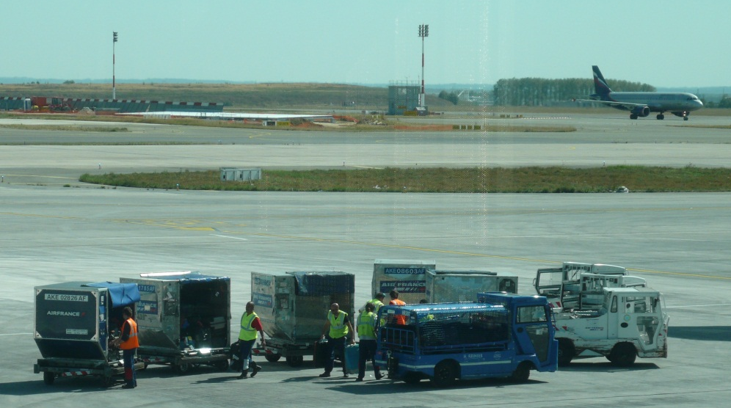
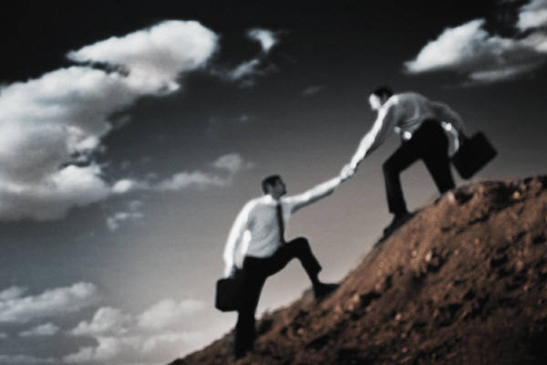
Teamwork - leadership
What is good leadership?
What is good followership?

Slide 8
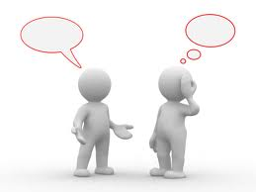
Teamwork - Communication
Notes:
Ask one of the trainees to describe a figure that you are going to draw on the white board
Make sure it takes you few times to draw it right.
Let them experience it by letting them sit with the backs to eachother. One has to draw a figure that the other has on a paper and describes.
Responsibiliteis transmitter and listener
Tune in tune in
Deliver listen
Check understanding demonstrate understanding

Slide 9
Teamwork - Communication
SENDER
FILTER
FEEDBACK
Message
Noise
FILTER
Receiver

Slide 10
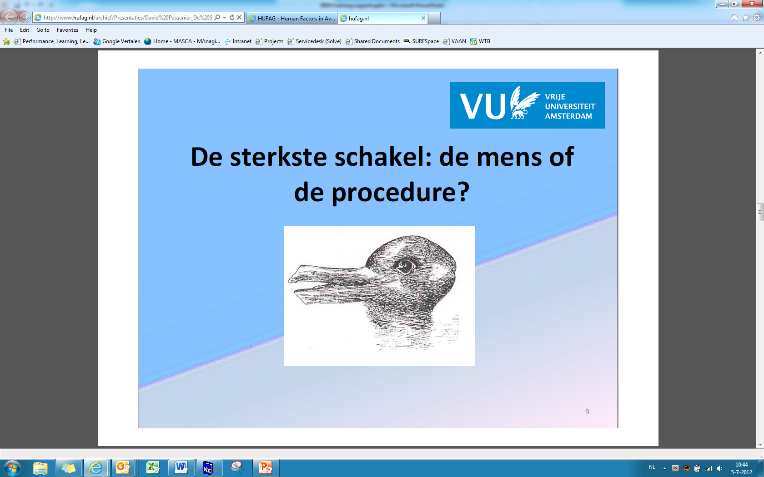
Teamwork - communication

Slide 11

Teamwork - communication

Slide 12
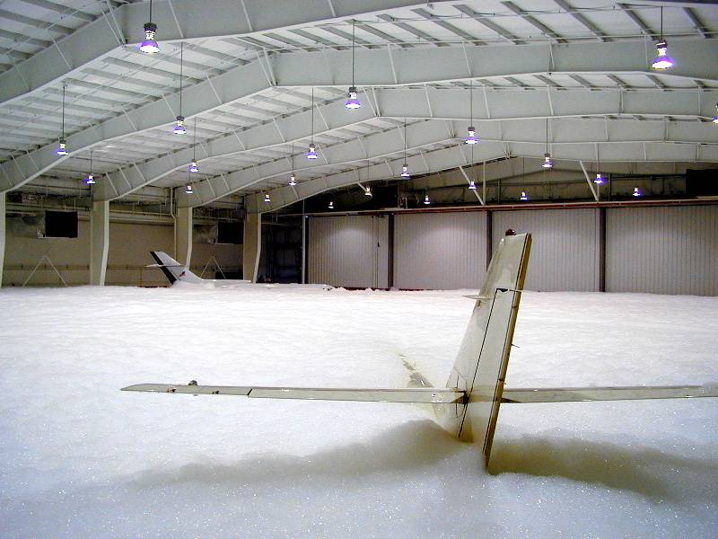
Teamwork - communication
Don, turn it off – or – Don’t turn it off?

Slide 13
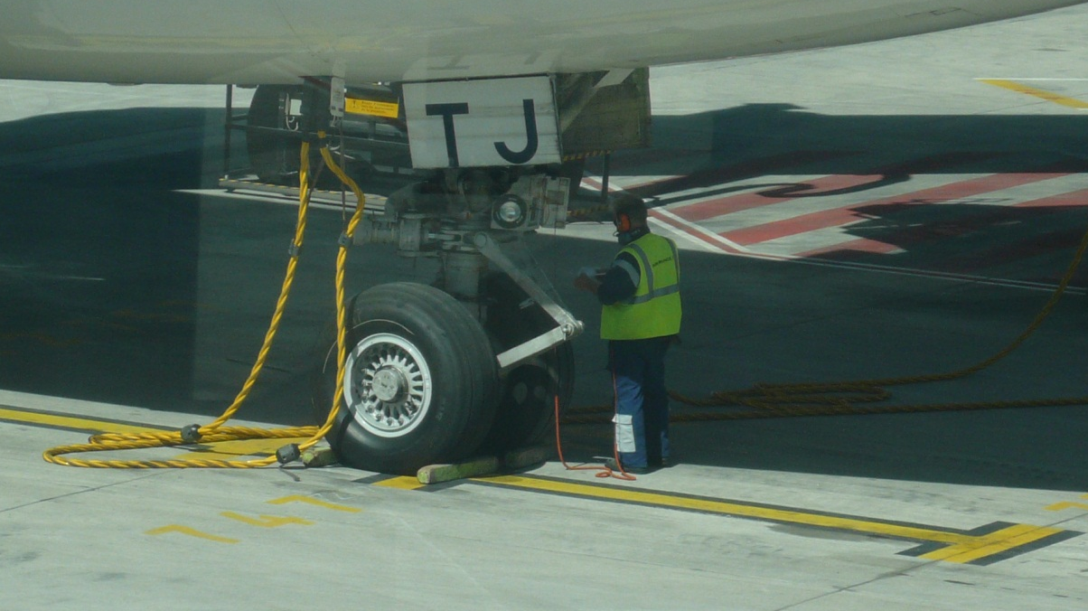
Teamwork - communication
Most important conditions
  Listen!
  Clarity
  Not open for interpretation
  Short
  AND....

Slide 14

Teamwork - communication
Don’t assume, check!

Slide 15
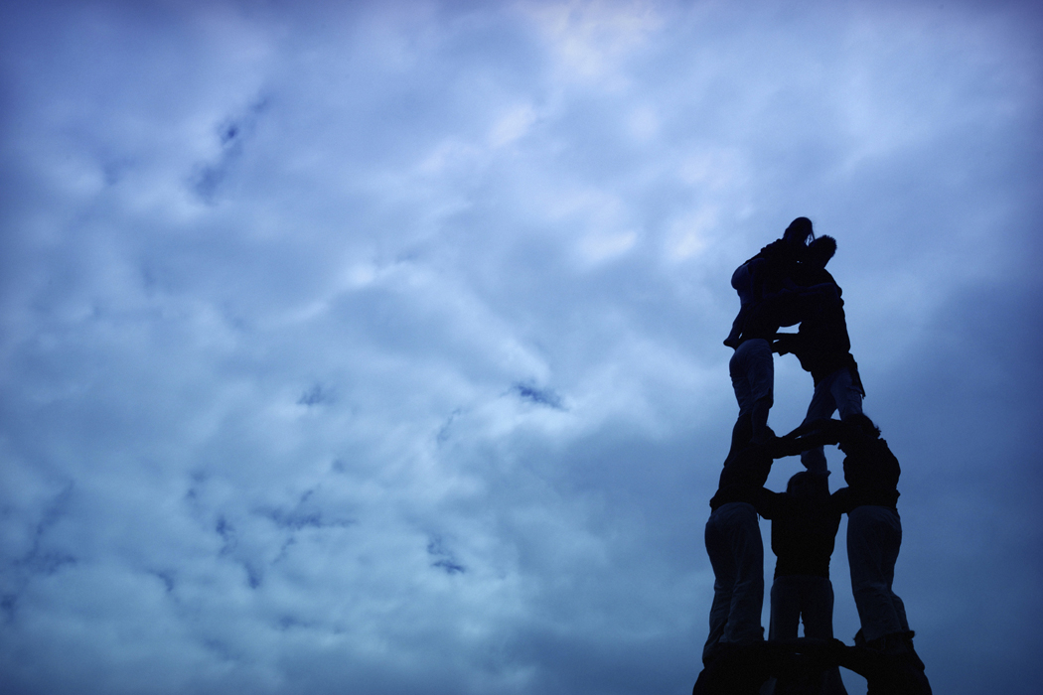
Exercise
Lost on the moon!

Slide 16
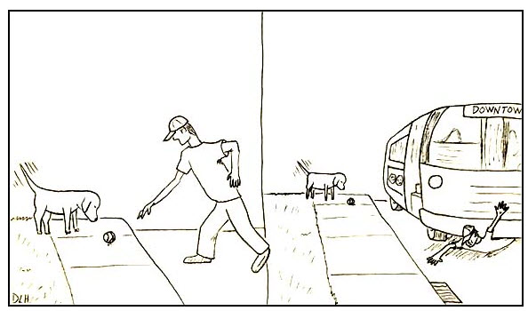
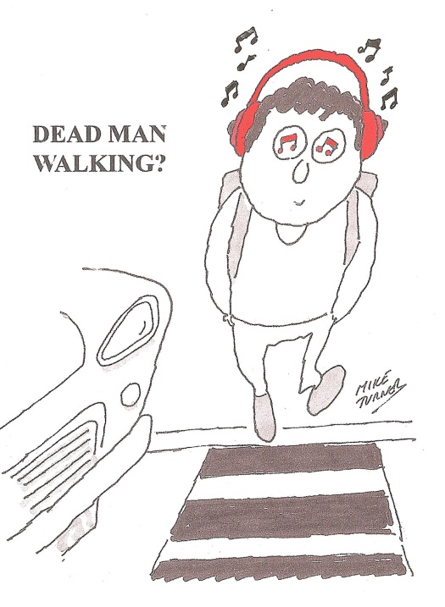

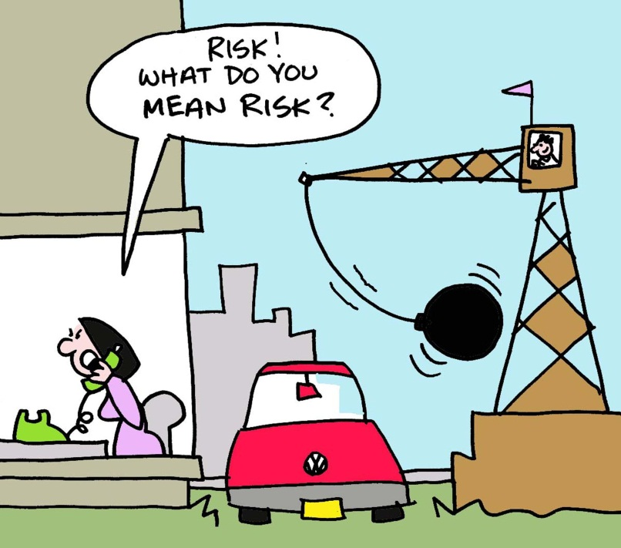
Teamwork – Team situational awareness
Notes:
Ask what situational awareness is?
What is team situational awareness?
Know what you are doing and why
Know what is going on around you
Note : The entire team may be involved in incident/accident investigation – this increases team responsibility.
Ask what you can do to keep situational awareness (white board)
Predetermine roles
Plan
Solicit input
Evaluate your status
Project ahead
Scan but focus on details
Create reminders
Watch for clues for loss of situational awareness

Slide 17
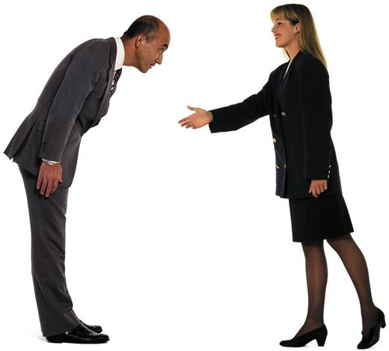
Teamwork - Cultural differences
Notes:
Emphasize the Cultural, ethnic and educational difference they have to deal with
Foreign airline – foreign crew
Co-workers from different parts of the country/continent/world
Co-workers with extensive/no experience (permanent vs temporary workers)
The ability of everyone in the organisation to work together with mutual respect is a vital element of an organisation’s safety culture.
Ask for experiences and how they deal with the differences
Emphasize that defining team roles, as discussed in team situational awareness, helps to deal with cultural differences.

Slide 18
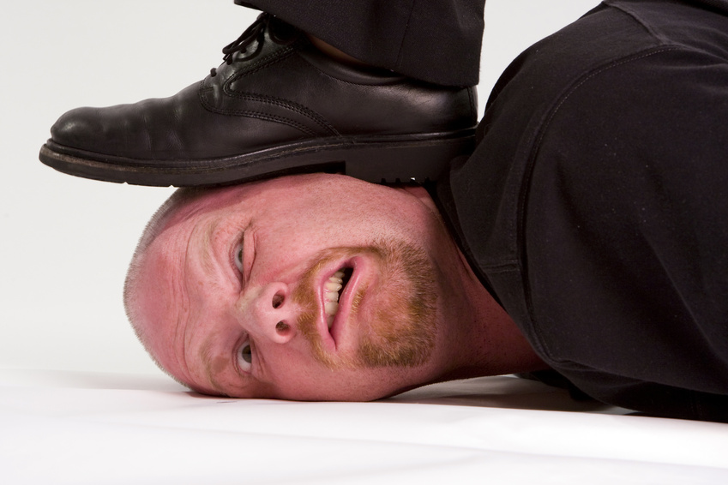
Teamwork - Behaviour is a choice
Notes:
Explain the behaviors you can choose of by developing the diagram of ‘smooth, avoid, force with respect and compromise’ on the board with use of the examples below
E.G:
Smooth: Girlfriend wants to go out for dinner after a busy day.
Avoid: You go and behave Muddy path and person takes a lot of place or hasty car that takes over...you are not paid to teach the other person a lesson
Compromise: Kid sick and you have an important meeting
Force with respect: Plain to catch and a bus with tourists is very slow
How important is the relationship
What you want or need
Smooth 1
Avoid 2
Compromise 3
Force with respect 4
E.G:
1: Girlfiend wants to go out for dinner after a bussy day. You go and behave
2: Mudy path and person wants takes a lot of place or hasty car that takes over...you are not paid
to teach the other person a lossong
3: Kid sick and you have an important meeting. What do you do?
4: Plain to catch and a bus with tourists is very slow
Short and longterm

Slide 19
Teamwork - Behaviour
What you give is what you get!
Boomerang video

